Slide 1
Ms
Weather and Climate
Mrs. Peters
Using Trade Books
with NGSS
3-ESS2-1
3-ESS2-2
3-ESS3-1
ELA RI.3.1
ELA RI.3.9
ELA W.3.1
ELA W.3.7
ELA W.3.9

Slide 2
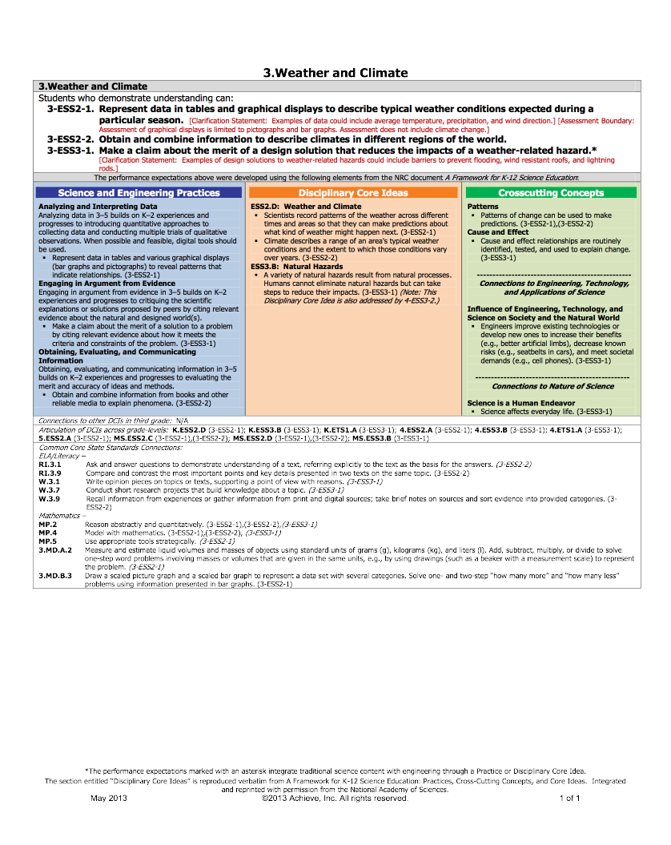

Slide 3
Teacher Notes
Where in the World is Edward Tulane?
As you read, record details on the weather and climate of the region to discover “Where in the World is Edward Tulane?”
Key Ideas and Details:
CCSS.ELA-Literacy.RI.3.1
Ask and answer questions to demonstrate understanding of a text, referring explicitly to the text as the basis for the answers.
Integration of Knowledge and Ideas:
CCSS.ELA-Literacy.RI.3.9
Compare and contrast the most important points and key details presented in two texts on the same topic.
Text Types and Purposes:
CCSS.ELA-Literacy.W.3.1
Write opinion pieces on topics or texts, supporting a point of view with reasons.
Research to Build and Present Knowledge:
CCSS.ELA-Literacy.W.3.7
Conduct short research projects that build knowledge about a topic.
CCSS.ELA-Literacy.W.3.9
Recall information from experiences or gather information from print and digital sources; take brief notes on sources and sort evidence into provided categories.

Slide 4
Outcomes/Objectives
3-ESS2-1 Represent data in tables and graphical displays to describe typical weather conditions expected during a particular season.
Disciplinary Core Ideas
ESS2.D: Weather and Climate
•Scientists record patterns of the weather across different times and areas so that they can make predictions about what kind of weather might happen next. (3-ESS2-1)
Science and Engineering Practices
Analyzing and Interpreting Data
Analyzing data in 3–5 builds on K–2 experiences and progresses to introducing quantitative approaches to collecting data and conducting multiple trials of qualitative observations. When possible and feasible, digital tools should be used.
•Represent data in tables and various graphical displays (bar graphs and pictographs) to reveal patterns that indicate relationships. (3-ESS2-1)
Engaging in Argument from Evidence
Engaging in argument from evidence in 3–5 builds on K–2 experiences and progresses to critiquing the scientific explanations or solutions proposed by peers by citing relevant evidence about the natural and designed world (s).
•Make a claim about the merit of a solution to a problem by citing relevant evidence about how it meets the criteria and constraints of the problem. (3-ESS3-1)
Outcomes/Objectives:
SWBAT: Act like a scientists by recording patterns of the weather across different times and areas so that they can make predictions about what kind of weather might happen next.
SWBAT: will create tables and graphical displays to describe typical weather conditions during the month of May.
SWBAT: Represent data in tables and various graphical displays (bar graphs and pictographs) to reveal patterns that indicate relationships. (3-ESS2-1)
SWBAT: Engaging in argument from evidence, experiences and progresses to critiquing where Edward Tulane is located.
SWBAT: will analyze the scientific explanations or solutions proposed by peers by citing relevant evidence about the natural and designed world (s).
SWBAT: Make a claim about the merit of a solution to a problem by citing relevant evidence about how it meets the criteria and constraints of the problem (Where in the World is Edward Tulane?). (3-ESS3-1)

Slide 5
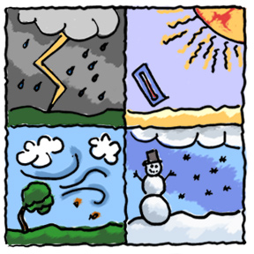
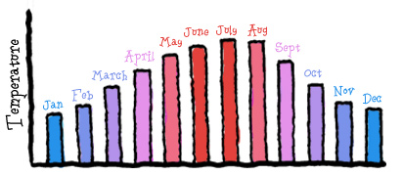
What is the Difference Between Weather and Climate?
Cue/Opener
http://www.makemegenius.com/science-videos/grade_3/weather-vs.-climate-for-kids
Students read the passage “What is the difference between weather and climate?” Working in groups or partners, complete the T – Chart.
Weather Climate
Day 100 Years
Hour Million Years
Changes quickly Changes slowly
Temperature, cloudiness, humidity Latitude, altitude, wind patterns and how far from ocean
Source: https://eo.ucar.edu/kids/green/what1.htm

Slide 6
Name:
What is the difference between
weather and climate?
Weather is how a place feels at a particular moment
Weather is what the forecasters on the TV news predict each day. They tell people about the temperature, cloudiness, humidity, and whether a storm is likely in the next few days. That’s weather!
It is the mix of events that happens each day in our atmosphere. Weather is not the same everywhere. It may be hot and sunny in one part of the world, but freezing and snowy in another.
Climate is how the weather in a place feels for a long period of time
Climate is the average weather in a place over many years.
While the weather can change in just a few hours, climate takes hundreds, thousands, even millions of years to change. The climate of an area is caused by its latitude, altitude, wind patterns and how far the area is from the ocean.
Source: https://eo.ucar.edu/kids/green/what1.htm

Slide 7
What is the Difference Between Weather and Climate?
Weather
Climate
Climate is what we expect, weather is what we get.

Slide 8
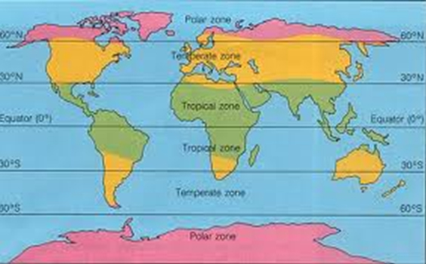
Climate
Climate is how the weather in a place feels for a long period of time.
There are three main climate zones:
· Polar zones, round the North and South Poles
· Tropical zones, round the Equator
· Temperate zones, in between the Tropical and Arctic zones

Slide 9
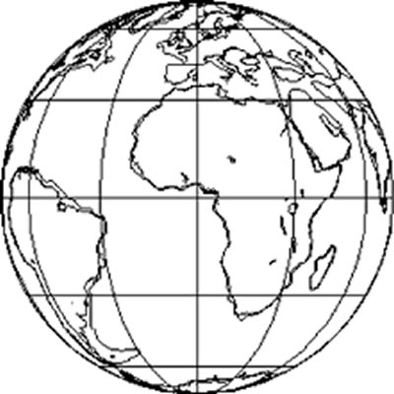
Name:
Climate is how the weather in a place feels for a long period of time. It is the characteristic weather of a region
There are three main climate zones: tropical, temperate and polar. On the map below color the zones and key.
Tropical
Temperate
Polar
http://oceanography.earthednet.org/W2005/Index.html

Slide 10
Name:
Read the passage below independently, highlight key ideas.
With your group/partner, decide together on the definition of a polar climate
Polar Climate
The polar climate is located the areas around the north and south poles. This area is covered by snow and ice all year and the temperatures are always freezing. All of the water is frozen and plants do not grow in the polar climate. Very few people, other than scientist, live in this area.
As you move closer to the equator within the polar area, you will find the Sub-Arctic zone. Winter temperatures remain below zero and the rivers and lakes remain frozen in the Sub-Artic zone, but in the summer there is a thaw. During the summer thaw, plants on the tundra can support animal life.
Polar climates are extremely cold, because they get less sunlight. The poles are located farther from the sun and the suns rays hit the poles at an angle. This is called indirect light which causes colder temperatures. The angle of the sun also causes the days to be long in the summer, and short in the winter. The winter polar nights last for six months. This causes even colder temperatures, the lowest temperature ever recorded was -126°F (-88°C).
Polar climates tend to be dry because cold air lacks moisture. This prevents clouds from forming, and without clouds there is no snowfall or rain. Some polar areas get less than 10 inches of rain or snow a year.
Polar Climate: ______________________________________________________
__________________________________________________________________
__________________________________________________________________
__________________________________________________________________
__________________________________________________________________
__________________________________________________________________
__________________________________________________________________
Modified from source: http://www.enviropedia.org.uk/Climate/Polar_Climate.php
http://www.weatherforkids.org/climate.html

Slide 11
Name:
Read the passage below independently, highlight key ideas.
With your group/partner, decide together on the definition of a tropical climate
Tropical Climate
The area near the equator is the tropical climate. This area experiences hot and humid weather. The hot temperatures are caused by the sun hitting directly on this part of the Earth. The tropics are located in the middle of the Earth and is closer to the sun. This is direct light causes hot temperatures.
There is also plenty of rainfall due to the warm air moving upward. During certain times of the year, thunderstorms can occur every day. Don’t let the rain fool you, the tropical climate still gets large amounts of sunshine, even with the excessive rainfall. This rain and sun provides ideal growing conditions for plants.
Temperatures in the tropical climate stay the same all year. Seasons in tropical climates do exist, but they are not know for warm and cold temperatures. The seasons are know by how much rain falls. There are two wet and two dry seasons. As you move away from the equator, the two rainy seasons join into one, and the climate becomes more monsoonal (one wet season and one dry season). In the Northern Hemisphere, the wet season occurs from May to July, in the Southern Hemisphere from November to February.
Tropical Climate: ___________________________________________________
__________________________________________________________________
__________________________________________________________________
__________________________________________________________________
__________________________________________________________________
__________________________________________________________________
__________________________________________________________________
Modified from source: http://www.enviropedia.org.uk/Climate/Polar_Climate.php
http://www.weatherforkids.org/climate.html

Slide 12
Name:
Read the passage below independently, highlight key ideas.
With your group/partner, decide together on the definition of a temperate climate
Temperate Climate
Temperate climates are those without extreme high or low temperatures. This means that temperatures are not burning hot nor freezing cold, temperate means moderate. The temperate climates are located between the tropical climate and polar climates. This means that some time areas are farther from the sun with indirect light (which causes colder temperatures.) At other times, this area is closer to the sun and with direct light (which causes warmer temperatures.)
Temperate climates do not have areas where it rains or snows all year, or area with little to no precipitation. The changes between summer and winter are somewhat quick, without being extreme. Unlike in the tropics, temperatures can vary greatly here, between summer and winter. So, most places with a temperate climate have four seasons: summer, autumn, winter and spring. Some areas with a temperate climate can have very unpredictable weather. One day it may be sunny, the next may be rainy, and after that it may be cloudy. This is usual in summer as well as in winter. The temperate climates can be divided into warm temperate climates and cool temperate climates.
Temperate Climate: _________________________________________________
__________________________________________________________________
__________________________________________________________________
__________________________________________________________________
__________________________________________________________________
__________________________________________________________________
__________________________________________________________________
Modified from source: http://www.enviropedia.org.uk/Climate/Polar_Climate.php
http://www.weatherforkids.org/climate.html

Slide 13
Climates
Compare and Contrast
Common Core ELA
Integration of Knowledge and Ideas:
CCSS.ELA-Literacy.RI.3.9
Compare and contrast the most important points and key details presented in two texts on the same topic.
Using the student identified important points and key details from the three major climate zones worksheets, have students compare and contrast the climates.
Suggestions:
Make a Xerox copy of the students papers, distribute giving each student two different climates
Work in pairs, giving each student a different climate
Work in groups, have students present their climate allowing each student to compare and contrast
Whole class activity
Draw an illustration of the differences

Slide 14
Compare and Contrast
Name:
Temperate vs. Tropical
Same
Different
Tropical vs. Polar
Polar vs. Temperate

Slide 15
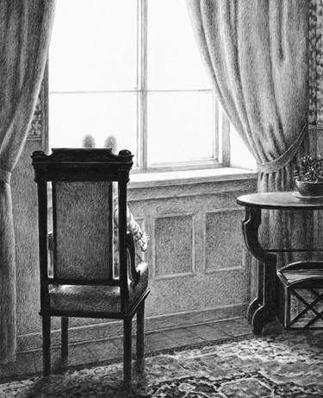
Name:
Where in the World is Edward Tulane?
Chapter 1
Of all the seasons of the year, the rabbit preferred winter, for the sun set early then and the dining room windows became dark and Edward could see his own reflection in the glass
What does this tell us?
Sources for Students:
http://www.kidsgeo.com/geography-for-kids/0075-day-length-effects-temperature.php
http://alaska.gov/kids/learn/daylighthours.htm

Slide 16
Where in the World is Edward Tulane?
Chapter 1
“Of all the seasons of the year, the rabbit preferred winter, for the sun set early then and the dining room windows became dark and Edward could see his own reflection in the glass”
What does this tell us?
Edward does not live in near the equator or the poles. If he lived near the equator, the days would not be noticeably longer and in the poles it would be darker due to the winter polar nights.
He likely lives in a Temperate Climate
Sources for Students:
http://www.kidsgeo.com/geography-for-kids/0075-day-length-effects-temperature.php
http://alaska.gov/kids/learn/daylighthours.htm
Key Ideas and Details:
CCSS.ELA-Literacy.RI.3.1
Ask and answer questions to demonstrate understanding of a text, referring explicitly to the text as the basis for the answers

Slide 17
Name:
Weather
Weather: It describes the condition of the air at a particular time and place. The conditions can be cloudy, sunny, partly cloudy, raining, snowing or any other weather we see. Weather also tells how the air moves (wind) and describes anything it might be carrying such as rain, snow or clouds. Thunder, lightning, rainbows, haze and other special events (called severe weather) are all part of weather. http://www.weatherwizkids.com
Visit an online weather site to find your current weather
http://www.weather.com/
City: _______________________________
Temperature:________________________
Conditions:__________________________
Wind:_______________________________
Amount of precipitation:________________

Slide 18
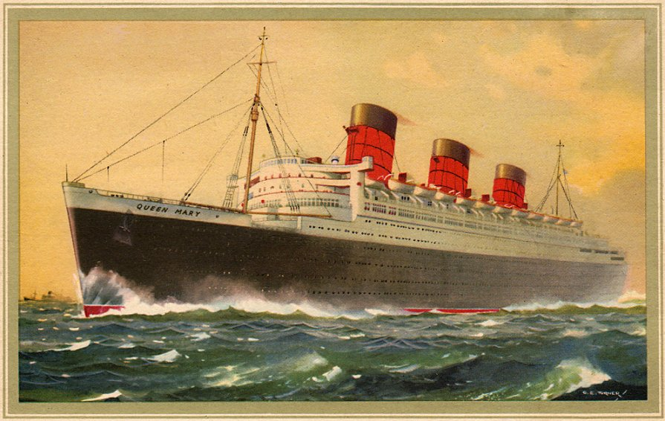
Where in the World is Edward Tulane?
Chapter 3
“She is called the Queen Mary,” said Abilene’s father, “and you and your mama and I shall sail on her all the way to London.”
Chapter 5
And then, finally, on a bright Saturday morning in May, Edwards and Abilene were all on board the ship.
“What does he do?” Martin asked Abilene on their second day at sea.
What do we know?
What do we need to know?

Slide 19
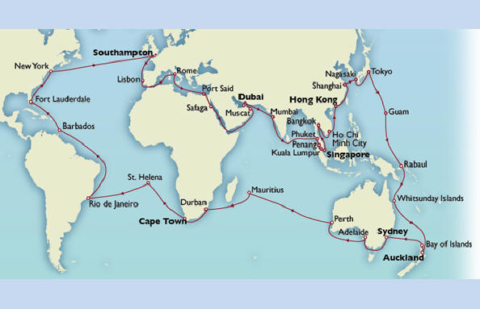
Where in the World is Edward Tulane?
Chapter 3
“She is called the Queen Mary,” said Abilene’s father, “and you and your mama and I shall sail on her all the way to London.”
Chapter 5
And then, finally, on a bright Saturday morning in May. Edwards and Abilene were all on board the ship.
“What does he do?” Martin asked Abilene on their second day at sea.
What do we know?
The ship was called the Queen Mary
It was a sunny day in May
They were at sea for at least 2 days
What do we need to know?
Routes of the Queen Mary to London, England from a place that is sunny in the spring. Also, the trip takes several days.
Sources for Students:
Queen Mary: Liner that helped launch monster cruise ships
http://www.bbc.com/news/magazine-29377549
The Queen Mary
http://www.historytoday.com/richard-cavendish/maiden-voyage-queen-mary
Weather in New York
http://www.accuweather.com/en/us/new-york-ny/10007/may-weather/349727
Key Ideas and Details:
CCSS.ELA-Literacy.RI.3.1
Ask and answer questions to demonstrate understanding of a text, referring explicitly to the text as the basis for the answers

Slide 20
Where in the World is Edward Tulane?
END
Queen Mary’s Routes
Have student pick a location (or teachers chooses a location) of a city on the Queen Mary’s route. End location of London is near Southampton.
In groups, partners or individuals, have students use an online weather site (or print the monthly recorded weather) to represent the weather in May on a table or graph.
See sample worksheets for line and bar graph
Compare result to determine “Where in the World is Edward Tulane?
http://www.weather.com/
New York
http://www.weather.com/weather/monthly/l/USNY0996:1:US
Fort Lauderdale
http://www.weather.com/weather/monthly/l/USFL0149:1:US
Barbados
http://www.weather.com/weather/monthly/l/BGI:9:BB

Slide 21
Temperature
Line Graph of Recorded May Temperatures
City: ____________________________
Days
Name:

Slide 22
Bar Graph of
May Weather Conditions City: ____________________________
Name:
Source: http://free-stock-illustration.com/

Slide 23
Where in the World is Edward Tulane?
Based on the evidence we have collected, where do you
think Edward boarded the Queen Mary?
Look back in the book, what type of clothing were the people wearing?
What type of weather does this indicate?
Using the sources on the Queen Mary, what evidence did you find?

Slide 24
They were most likely sailing from New York.
May weather in New York is typically sunny and not too hot.
Edward was wearing a scarf, which indicates a mild temperature.
New York is in the Temperate Climate Zone.
According to the Queen Mary source, a trip from New York to London took 4 days.

Slide 25
Special events or extreme weather are part of our weather
•Thunderstorm: rain, clouds, lightning, thunder, wind
•Tornado: clouds, strong wind, rain, hail
•Hurricane or cyclone: strong wind, heavy rain
•Blizzard: heavy snow, ice, cold temperatures
•Dust storm: strong winds, arid conditions
•Flood: heavy rainfall
•Hail storm: cold or warm temperatures, rain, ice
•Ice storm: freezing rain
Follow the link from National Geographic
Lesson: Extreme Weather on Our Planet
http://education.nationalgeographic.com/activity/extreme-weather-on-our-planet/
What is weather like on Earth?
What conditions lead to extreme weather events?
Activity Overview: Students use prior knowledge, a photo gallery, and a video to discuss what they already know about extreme weather on Earth and brainstorm a list of weather-related words. Then they organize the information they learned about weather events and conditions present for each type of weather event, and compare and contrast weather events and conditions.
Use the evidence gathered from the activity to determine the extreme weather that Edward Tulane experienced
Students will analyze the scientific explanations or solutions proposed by peers by citing relevant evidence about the natural and designed world
CCSS.ELA-Literacy.W.3.9
Recall information from experiences or gather information from print and digital sources; take brief notes on sources and sort evidence into provided categories.

Slide 26
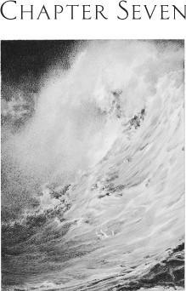
Name:
What Type of Weather for Edward Tulane?
Chapter 7:
On the two hundred and ninety-seventh day of Edward’s ordeal, a storm came. The storm was so powerful that it lifted Edward off the ocean floor and led him in a crazy, wild and spinning dance. The water lifted him up and shoved him back down.
Help thought Edward
The storm, in its ferocity, actually flung him all the way out of the sea; and the rabbit glimpsed, for a moment, the light of an angry and bruised sky, the wind rushed through his ears.
Use the relevant evidence gathered from
“Extreme Weather on Our Planet”
to determine the extreme weather that
Edward Tulane experienced.
Write an opinion piece to support your point of view with reasons from text and
Extreme Weather on Our Planet activity
Text Types and Purposes:
CCSS.ELA-Literacy.W.3.1
Write opinion pieces on topics or texts, supporting a point of view with reasons.

Slide 28
What Type of Weather for Edward Tulane?
Chapter 7:
On the two hundred and ninety-seventh day of Edward’s ordeal, a storm came. The storm was so powerful that it lifted Edward off the ocean floor and led him in a crazy, wild and spinning dance. The water lifted him up and shoved him back down.
Help thought Edward
The storm, in its ferocity, actually flung him all the way out of the sea; and the rabbit glimpsed, for a moment, the light of an angry and bruised sky, the wind rushed through his ears.
(About 10 months – March)
Use the evidence gathered from
“Extreme Weather on Our Planet”
to determine the extreme weather that
Edward Tulane experienced
Hurricane or cyclone: strong wind, heavy rain
See next pages for guide and rubric

Slide 29
What Type of Weather for Edward Tulane?
Opinion Piece
Name:
Introduction (Write a statement that introduces the topic)
Opinion (Clearly states your opinion on the type of weather Edward experienced):
Support (Provide information from the Science Unit that supports your opinion):
Support (Provide information from Edward Tulane text that supports your opinion):
Reasoning (Explain why your reasoning supports your opinion):
Conclusion (Statement that supports your opinion):
Text Types and Purposes:
CCSS.ELA-Literacy.W.3.1
Write opinion pieces on topics or texts, supporting a point of view with reasons.

Slide 30
Opinion Writing Rubric
You got
it!
Kinda
Not yet
Introduces the topic in a clear and creative way
Clearly states your opinion
Support from science unit AND from book
Reasoning supports your opinion
Concluding statement that supports your opinion

Slide 31
Oh No! Now What Happened to Edward!
How Can We Help?
NGSS
3-ESS3-1: Make a claim about the merit of a design solution that reduces the impacts of a weather-related hazard.* [Clarification Statement: Examples of design solutions to weather-related hazards could include barriers to prevent flooding, wind resistant roofs, and lightning rods.]
Cause and Effect
Cause and effect relationships are routinely identified, tested, and used to explain change. (3-ESS3-1)
Connections to Engineering, Technology, and Applications of Science
Influence of Engineering, Technology, and Science on Society and the Natural World
Engineers improve existing technologies or develop new ones to increase their benefits (e.g., better artificial limbs), decrease known risks (e.g., seatbelts in cars), and meet societal demands (e.g., cell phones). (3-ESS3-1)
Engaging in Argument from Evidence
Engaging in argument from evidence in 3–5 builds on K–2 experiences and progresses to critiquing the scientific explanations or solutions proposed by peers by citing relevant evidence about the natural and designed world (s).
Make a claim about the merit of a solution to a problem by citing relevant evidence about how it meets the criteria and constraints of the problem. (3-ESS3-1)
Connections to Nature of Science
Science is a Human Endeavor
Science affects everyday life. (3-ESS3-1)
Common Core
CCSS.ELA-Literacy.W.3.9
Recall information from experiences or gather information from print and digital sources; take brief notes on sources and sort evidence into provided categories.

Slide 32
Oh No! Now What Happened to Edward!
How Can We Help?
What would happen to Edward if he was in a severe storm?
Think about the severe weather we discussed in the “Extreme Weather on Our Planet” activity.
Think about an experience you’ve had in a severe storm and/or a storm you’ve seen on TV, in a movie or online. What was it like?
Use your imagination, what would it be like for Edward?
Share with a partner
If Edward was caught in one of these storms, how could we help him stay safe?
Let’s brainstorm some ideas….
Thunderstorm
Tornado
Hurricane or cyclone
Blizzard
Dust storm
Flood
Hail storm
Ice storm

Slide 33
Oh No! Now What Happened to Edward!
How Can We Help?
Science affects everyday life, part of science is engineering.
Engineers improve existing technologies or develop new ones to increase their benefits (e.g., better artificial limbs), decrease known risks (e.g., seatbelts in cars), and meet societal demands (e.g., cell phones)
Each group is assigned (or chooses) a type of severe storm. Your job as scientist and engineers is to develop a design for a device to keep Edward safe as he encounters a storm.
Students will
use information from experiences
gather information from print and digital sources
take brief notes on sources
make a claim about the merit of a solution to a problem by citing relevant evidence
Allow students to present to their peers. Encourage peers to critique their proposed solutions.

Slide 34
Type of severe storm:____________________________________________
Develop a design for a device to keep Edward safe as he encounters a storm.
Oh No! Now What Happened to Edward!
How Can We Help?

Slide 35
C
Credits
Sources sited on pages

