Slide 1
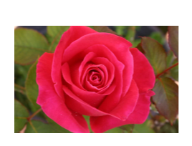
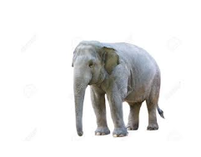
Plant and Animal
Super Senses, Structures and Communication
An elephant can smell from miles away, why is this important?
Why does it smell good & why does it have prickles?

Slide 2
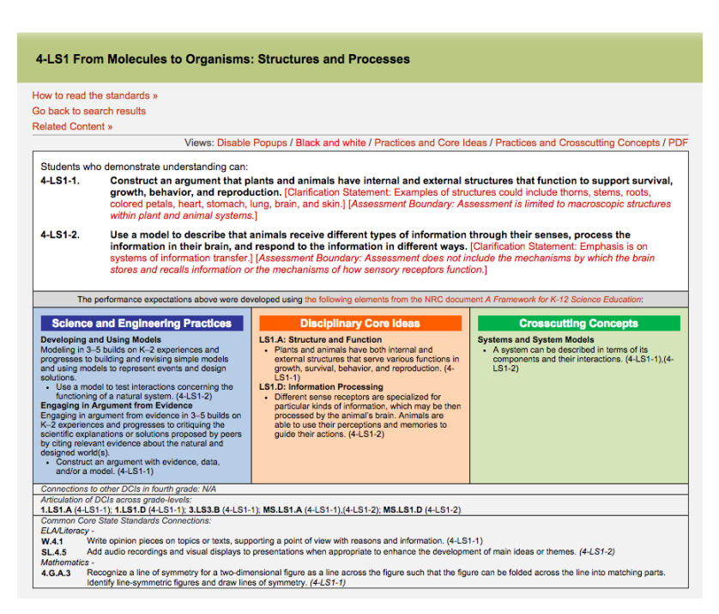

Slide 3
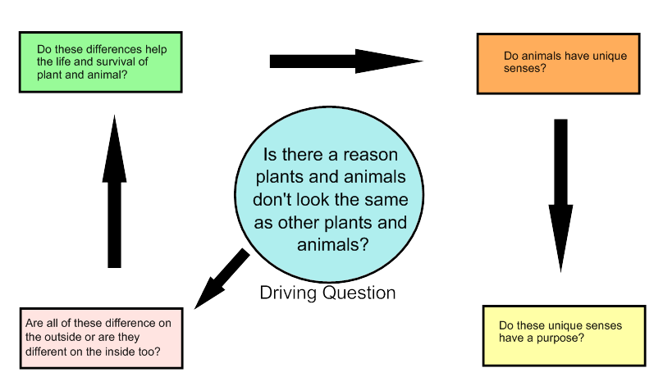

Slide 4
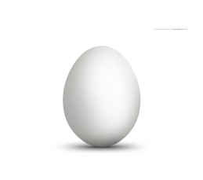
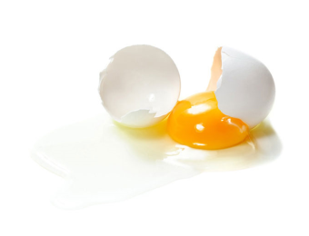
Internal and External Structures
External structures are on the outside and normally visible;
Internal structures are on the inside and normally not visible.
External
Internal
Shell
Yolk
Egg White

Slide 5
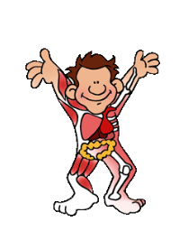
Internal and External structures

Slide 6
Internal and External structures
Skin
Hair
Nails
Heart
Bones
Stomach

Slide 7
Fold in half so the sides match in size and draw a line of symmetry.
List the External structures on the left and the Internal structures on the right.
Math 4.G.A.3
Recognize a line of symmetry for a two-dimensional figure as a line across the figure such that the figure can be folded across the line into matching parts. Identify line-symmetric figures and draw lines of symmetry. (4-LS1-1)

Slide 8
Do plants and animals have
internal and external structures?
With your partner, select any plant or animal, list the evidence of the internal and external structures.
Share with class
Do they all have internal and external structures?

Slide 9
We can all agree that both plants and animals have internal and external structures, but do they all have a specific purpose?
What is that purpose?
Discuss with your shoulder partner

Slide 10
Time Lapse of a Morning Glory
https://youtu.be/g6iSwNfCf3U
As you watch the video, list the ?structures and behaviors you observe.

Slide 11
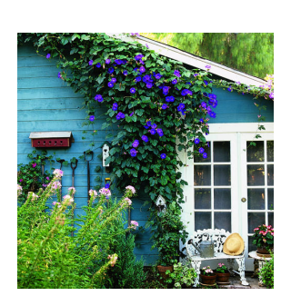
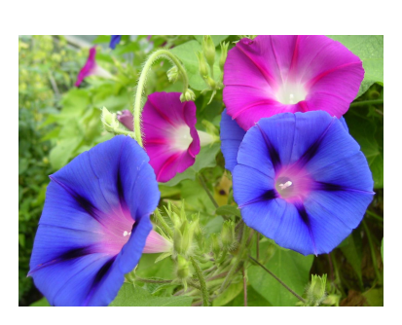
Flowers open during the day and close at night
New flower forms the next day
Vines
Deep Tube Flowers
Moves up toward sunlight
Morning Glory plants dilate in the morning, as water fills their veins. This ?vein-generated water action becomes pronounced as the day progresses ?and the flower is unable to maintain the water content, so it droops and ?withers as the morning progresses.

Slide 12
Plants have specific structures, each of these structures ?has a specific purpose or job:
Survival: a natural process resulting in the evolution of ?organisms best adapted to the environment, to stay alive
Growth: a process of becoming larger or more complex
Behavior: the action or reaction of something
Reproduction: the process of generating offspring

Slide 16
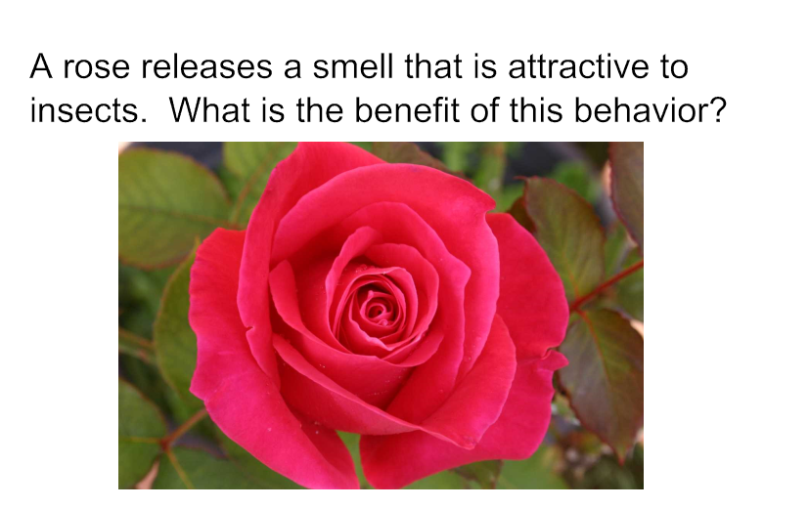

Slide 20
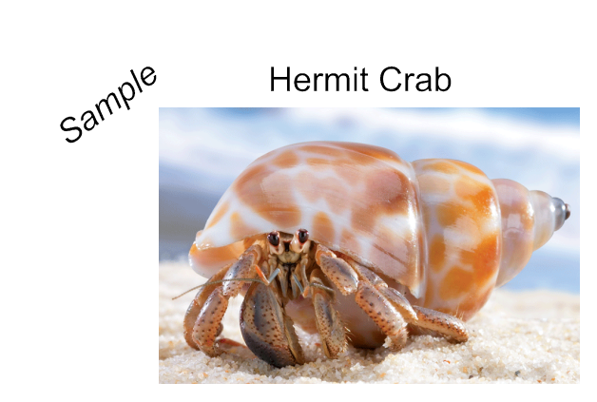
A hermit crab has internal and external structures that function
to support survival, growth, behavior, and reproduction.
For survival a hermit crab uses other animals' old shells for protection. As the hermit crab grows in size, it must find a larger shell.
To grow, a hermit crab eats plants and animals (omnivore) and dead animals that they find (scavengers). The right claws are larger than their left claws. The large right claw is used for the behavioral action of protection and holding food, and the small left claw for eating. For reproduction, hermit crabs mate. Male hermits are often seen dragging around a female by their small claw, fighting off other males with their big claw. The male will drag his potential mate around until she is ready to molt. When the female crab molts she is receptive and the male can then fertilize her eggs.

Slide 26
Answer: Yes and Yes
Animals have the same 5 senses as humans, some are more enhanced (better) while others maybe less effective.
They do have senses that we don't, such as:
Echolocation
Electric fields
Magnetic field detectors
Temperature sensors
Detect Ultra Violet light
Jacobs Organ

Slide 30
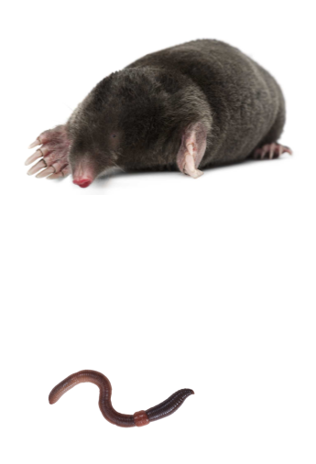
A mole has limited hearing and sight, but it has a heighten sense of touch using it's whiskers and hairs, which allows it feel vibrations. Even a mole's nose has sense of touch.
Why is this important?
A mole lives in tunnels underground and doesn't need sight and hearing as much as touch. It uses touch to find it's favorite food - earthworms.

Slide 31
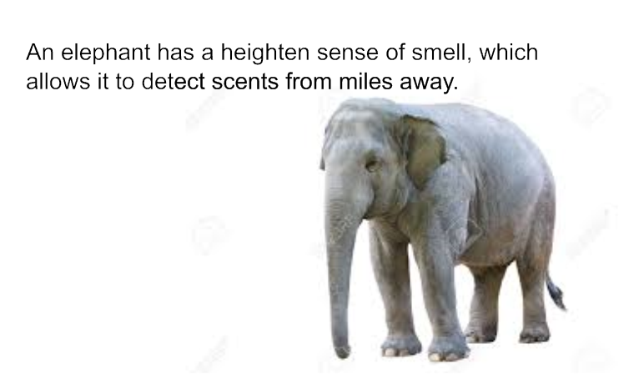
Why is this important?
Because it can detect water, food and predictors from miles away

