Slide 1
Determining Regional Climate
NGSS: Weather and Climate
MS-ESS2-6
CCSS SL8.5

Slide 2
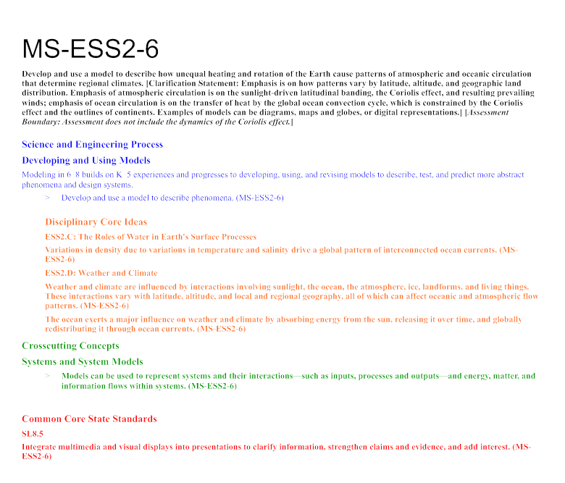

Slide 3
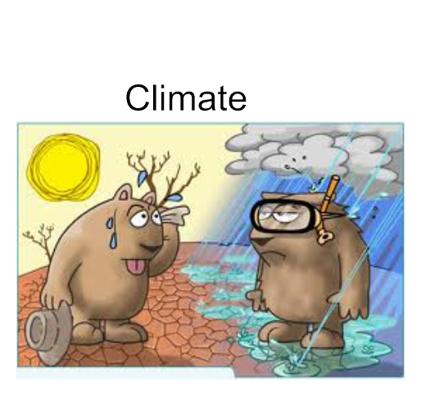

Slide 4
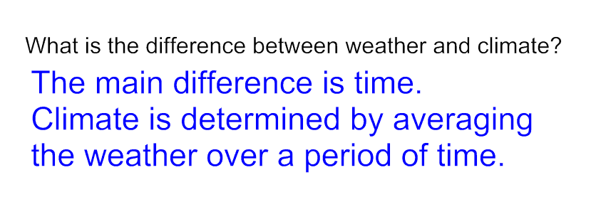
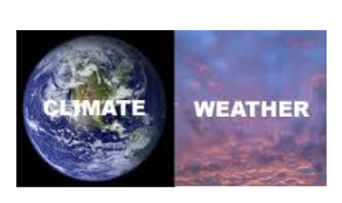
Climate is what we expect, weather is what we get.

Slide 5
Factors that affect the climate include:
Latitude
Topography
Location of Lakes and Oceans
Amount of Moisture
Global Wind Patterns
Ocean Currents
Location of Air Masses

Slide 9
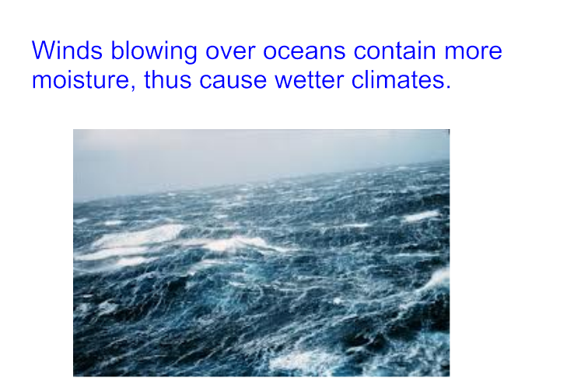

Slide 13
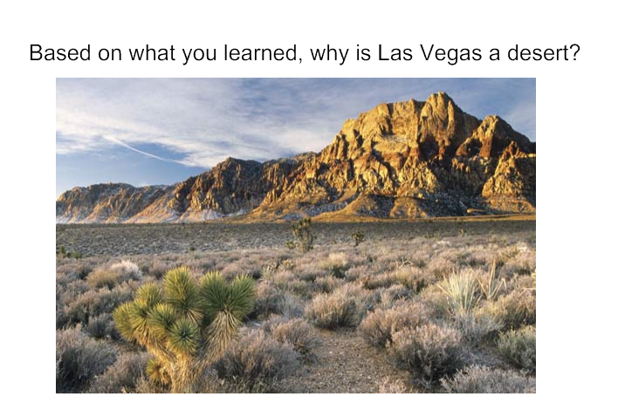

Slide 17
In groups of 4-6 use credible online resources to describe the climate of one of the cities listed below, and then create a Power Point or Google Presentation. Your presentation should include the following:
Name of city and location in the world (country and continent...)
Climate (see attached map) - Make a claim
Information about this particular type of climate that supports the claim. Must be based on the "Factors that Affect Climate."
Evidence to support the information (maps, data tables, graphs...)
Interesting facts about the climate of this city (at least 2)
Chicago, Illinois US Barcelona, Spain
Karakoram Himalaya, China Dhaka, Bangladesh
Miami, Florida US Soule, Korea
Kabul, Afghanistan Lisbon, Portugal
Central Sahara, North Africa Bouvet Island, Norway
Las Vegas, Nevada US Gandom-e Beryan, Dasht-e Lut, Iran
Rio de Janerio, Brazil Berlin, Germany
Summit Camp, Greenland Viña del Mar, Chile
Adelaide, South Australia Oymyako, Russian Siberia
Mumbai, India Mexico City, Mexico
Vostok Station, Antarctica Yukon Territory, Alaska US
Lima, Peru Cape Town, South Africa
Ho Chi Minh City, Vietnam San Diego, California US

Slide 18
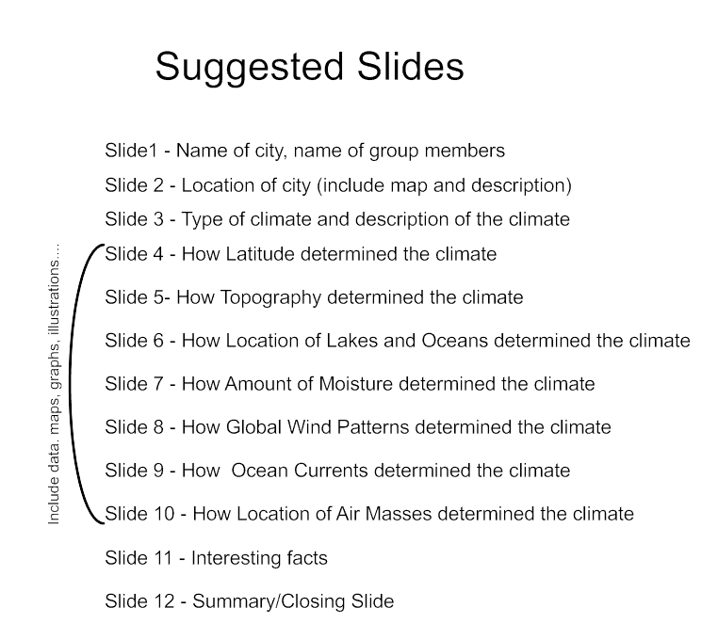

Slide 19
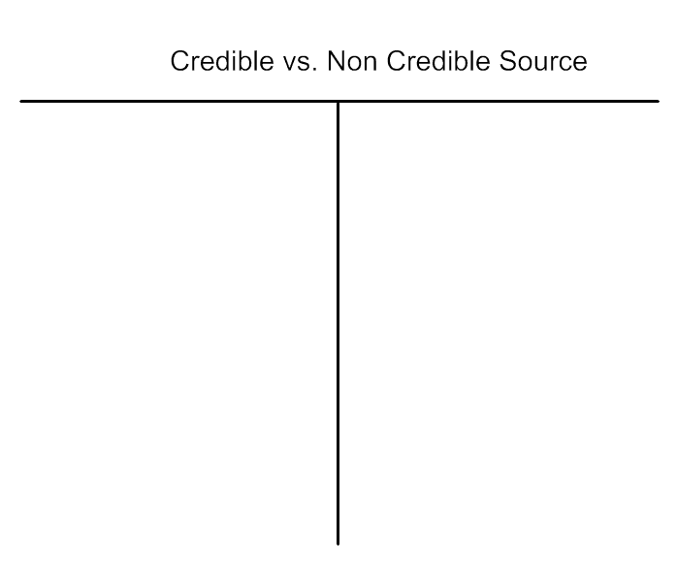

Slide 20
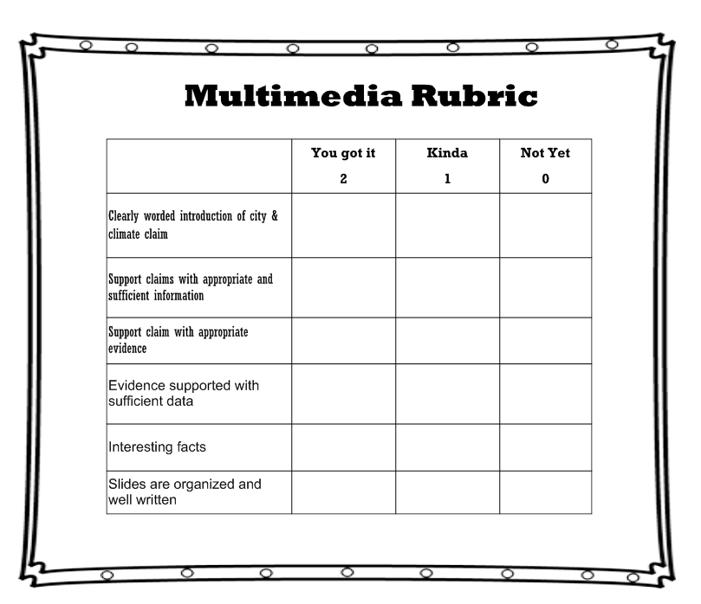

Slide 21
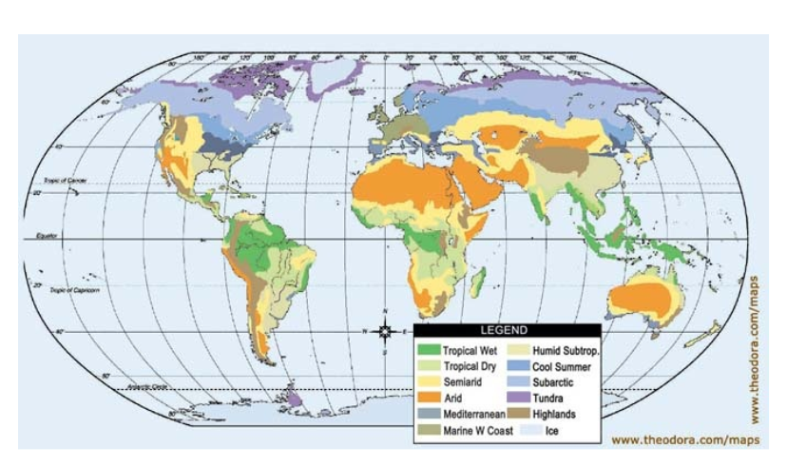

Slide 22
What is the difference between Maritime and Continental climates with regard to ocean currents?
Explain how interaction between ocean and atmosphere influence global and regional climates.

Slide 23
