Slide 1
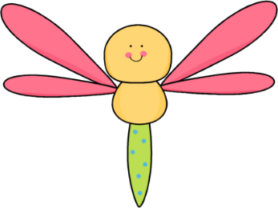
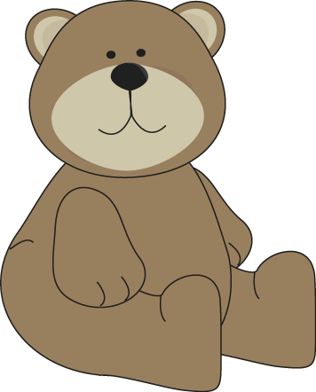
Plants & Animals
Use a model to represent the relationship between the needs of different plants and animals (including humans) and the places they live
Kindergarten
Science
Created by:
Mrs. peters
K-ESS3-1

Slide 3
EVIDENCE STATEMENTS
Observable features of the student performance by the end of the grade:
1. Components of the model
a) From the given model (e.g., representation, diagram, drawing, physical replica, diorama, dramatization, storyboard) of a phenomenon involving the needs of living things and their environments, students identify and describe the components that are relevant to their representations, including:
Different plants and animals (including humans).
The places where the different plants and animals live.
The things that plants and animals need (e.g., water, air, and land resources such as wood, soil, and rocks).
2. Relationships
a) Students use the given model to represent and describe relationships between the components, including:
The relationships between the different plants and animals and the materials they need to survive (e.g., fish need water to swim, deer need buds and leaves to eat, plants need water and sunlight to grow).
The relationships between places where different plants and animals live and the resources those places provide.
The relationships between specific plants and animals and where they live (e.g., fish live in water environments, deer live in forests where there are buds and leaves, rabbits live in fields and woods where there is grass to eat and space for burrows for homes, plants live in sunny and moist areas, humans get resources from nature [e.g., building materials from trees to help them live where they want to live]).
3. Connections
a) Students use the given model to represent and describe, including:
Students use the given model to describe the pattern of how the needs of different plants and animals are met by the various places in which they live (e.g., plants need sunlight so they are found in places that have sunlight; fish swim in water so they live in lakes, rivers, ponds, and oceans; deer eat buds and leaves so they live in the forest).
Students use the given model to describe that plants and animals, the places in which they live, and the resources found in those places are each part of a system, and that these parts of systems work together and allow living things to meet their needs.

Slide 4
Teacher Notes
NGSS
Use a model to represent the relationship between the needs of different plants and animals (including humans) and the places they live. [Clarification Statement: Examples of relationships could include that deer eat buds and leaves, therefore, they usually live in forested areas; and, grasses need sunlight so they often grow in meadows. Plants, animals, and their surroundings make up a system.]
Disciplinary Core Ideas
ESS3.A: Natural Resources
•Living things need water, air, and resources from the land, and they live in places that have the things they need. Humans use natural resources for everything they do.
CCSS
SL.K.5
Add drawings or other visual displays to descriptions as desired to provide additional detail. (K-ESS3-1)
A Framework for K-12 Science Education: Practices, Crosscutting Concepts, and Core Ideas ( 2012 )
http://www.nap.edu/openbook.php?record_id=13165&page=108
Grade Band Endpoints for ESS3.A
By the end of grade 2.
Living things need water, air, and resources from the land, and they try to live in places that have the things they need. Humans use natural resources for everything they do: for example, they use soil and water to grow food, wood to burn to provide heat or to build shelters, and materials such as iron or copper extracted from Earth to make cooking pans.

Slide 5
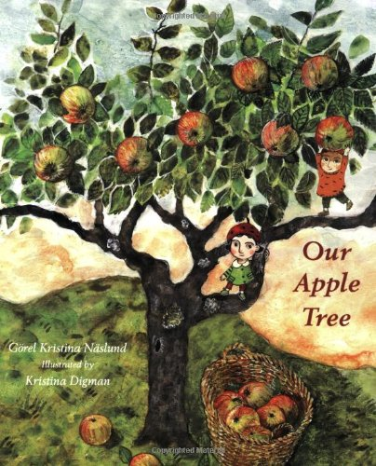
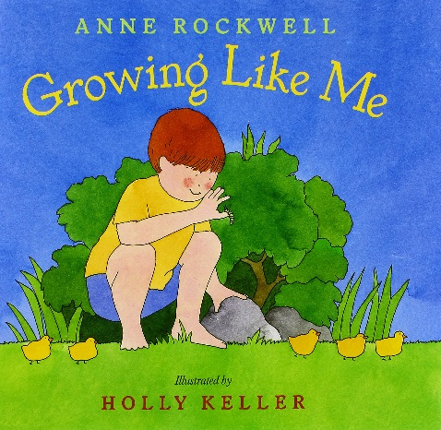
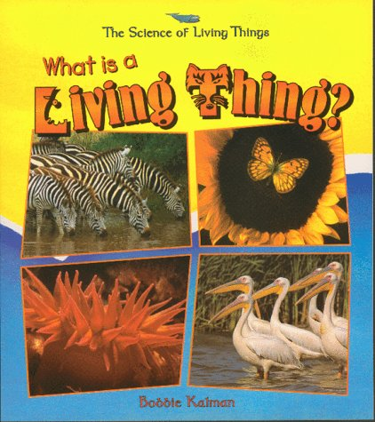
Suggested Book
For
Read Aloud
Our Apple Tree
August 8, 2006
by Gorel Kristina Naslund (Author),
Kristina Digman (Illustrator
Growing Like Me
March 1, 2001
By Anne Rockwell (Author), Holly Keller (Illustrator)
What Is a Living Thing? (Science of Living Things)
October, 1998
by Bobbie Kalman (Author)

Slide 6
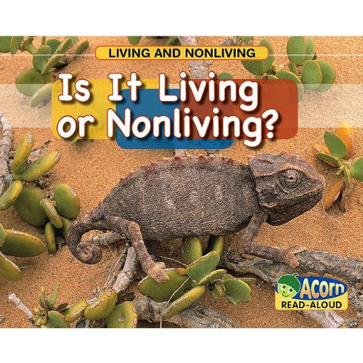
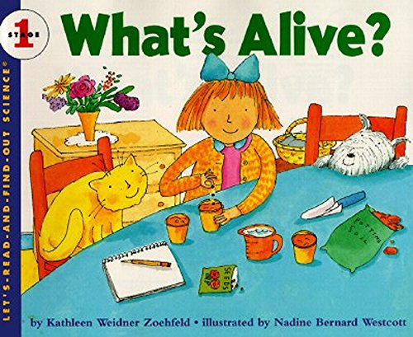
Suggested Book
For
Read Aloud
Our Apple Tree Paperback – August 8, 2006
by Gorel Kristina Naslund (Author),
Kristina Digman (Illustrator
Is It Living or Nonliving? (Living and Nonliving) Paperback – July 1, 2009
by Rebecca Rissman
What's Alive? (Let's-Read-and-Find-Out Science 1) Paperback – August 18, 1995
by Kathleen Weidner Zoehfeld (Author), Nadine Bernard Westcott (Illustrator)

Slide 7
Suggested Book
For
Read Aloud
In small groups have student try to move objects from one plate to another without using their hands or moving the plates. We are simulating a bee moving pollen or an animal moving seeds.
My suggestions is to use paper plates with fine pollen like substance such as salt or baby power, as well as a variety of seed type objects such as sesame seeds, poppy seeds, pumpkin or sunflower seeds….
Provide students with a spoon, tweezers, cotton balls, clothes pins, straws, Velcro, tape, feather, cloth, pipe cleaner… to move the objects
Probing questions: Which was easier to move the powder or the seeds? Why?
Which device worked the best? Why?
Read article and relate the objects to the types of animals involved in the pollination and seeding process.
Discuss students experience with pollination and seeding.
Have you seen insects on a flower?
Where have you seen a seed in fruit? Have you planted a seed? Have you accidently planted a seed?

Slide 8
What is Pollination?
Pollination is when animals move pollen from one plant to another. Pollination is a very important part of the life cycle of plants. Insects, birds, bats and the wind take pollen between flowering plants, which means the plants can make seeds and reproduce (have babies!).
Insects help plants to make seeds. When an insect sees the bright colors and smell of a flower, it tells them that the flower has sugary nectar to eat. Nectar is a sweet liquid that plants produce and animals eat. While eating the nectar from the flower, some of the pollen rubs off on the insect. Some insects like bees, have a dipped spot on their legs and curved hairs to hold the pollen. When the insect moves to the next flower, it takes the flower to the next plant. After the pollen goes into the flower, a seed can grow.
It is not only insects that pollinate plants. Birds, bats and sometimes the wind can also take pollen between plants, but 90% of pollination happens with animals rather than the wind.
Source: “What is Pollination?”
https://www.edenproject.com/learn/for-everyone/what-is-pollination-a-diagram-for-kids

Slide 9
What is Seeding
Seeding is when animals, wind or water help plants to scatter their seeds. The way they scatter the seeds has to do with the type of seed to be scattered.
Some animals eat the fruit that has fallen from the trees. When an animal eats fruit, often the seeds come out in their waste or droppings. When they go to the bathroom, it can plant the seeds. Some animals eat fruit, but drop part of the fruit and seeds onto the ground. An animal might eat the outer part, but leave the seed to grow in the grounds. Like when we eat an apple. We eat the tasty outer part, but leave the seeds.
Not all seeds are planted from an animal eating the plants. Some animals save the fruits or seeds and bury them to eat later, but forget about them. When this happens, the seeds starts to grow in their new hidden or forgotten spot.
Many plants produce fruits or seeds that are covered in hooks or spines. A hook or spine attached to the animals' fur or feathers. Even humans can have them stick to clothes or hair. In time, the seed may fall off, or be rubbed off by the animal. When the seed drops, it will grow into a new plant.
Although animals can move and plant seed, the wind and water can also carry seeds to a new location. Water in the rain, river or lake can move a seed. Strong winds can also carry a seed a very long distance to new spot to grow.

Slide 10
Name:
Use the divided foldable to model to describe that matter is made of particles too small to be seen.
Outside Flaps
Labeled
Pollination
Seeding
Inside Flap
Define
Pollination
Seeding
Inside Square
Draw a picture of an animal helping a plant pollinate.
Draw a picture of an animal helping a plant spread seeds.

Slide 11
Sample
Pollination
Seeding

Slide 12
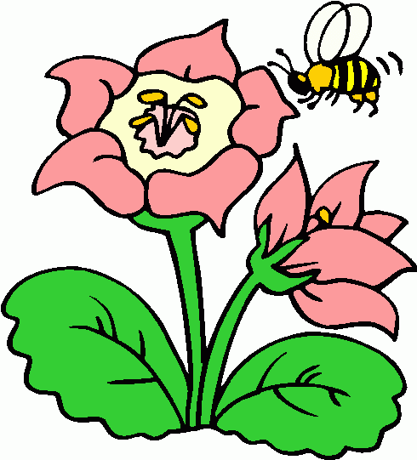
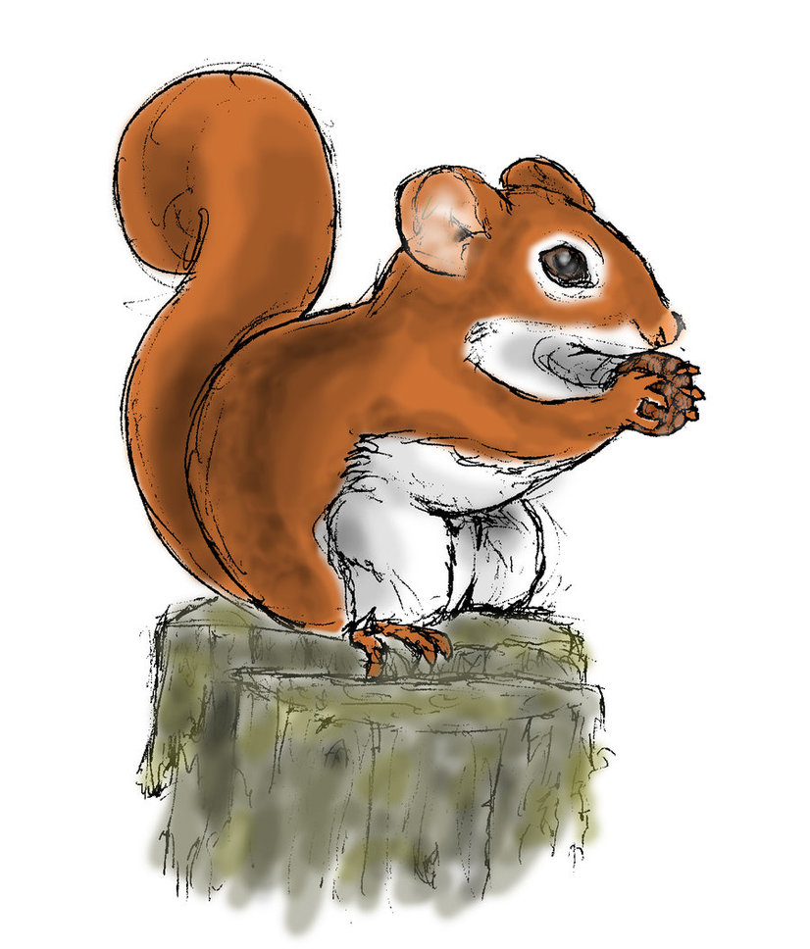
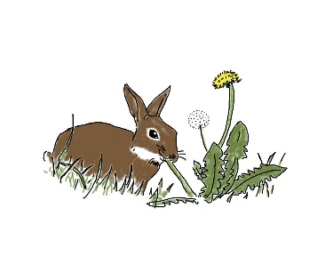
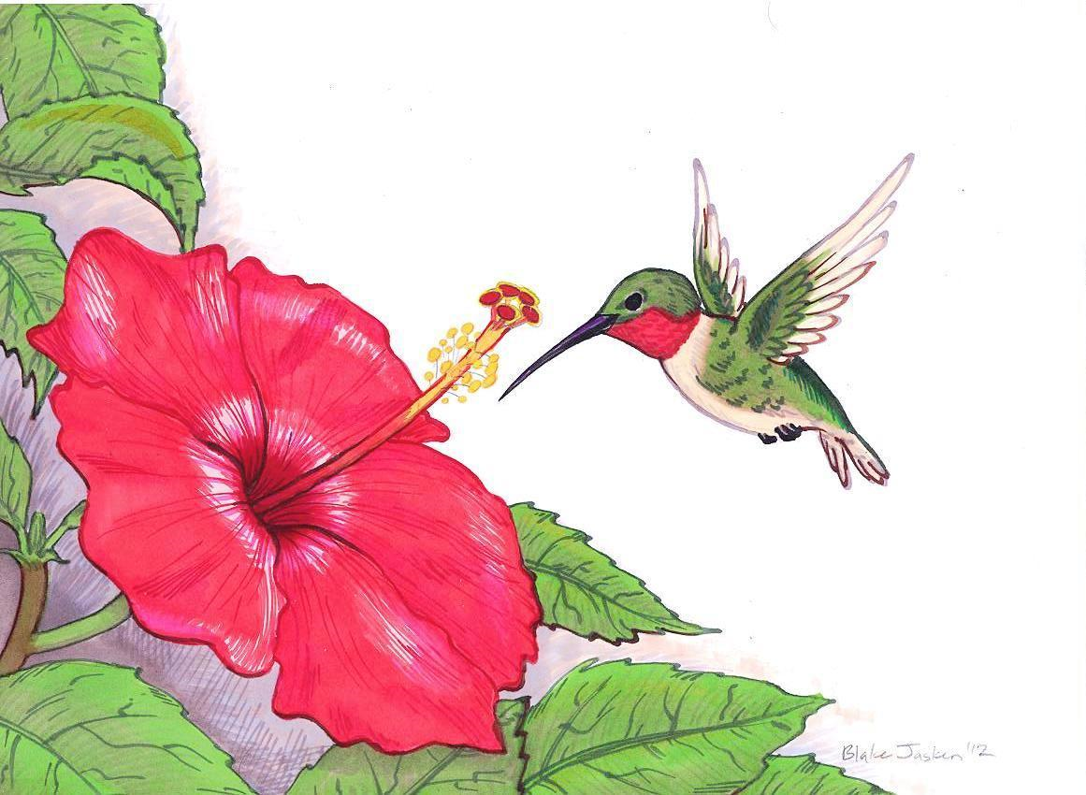
Sample
What is Pollination?
What is Seeding?
Pollination is when animals move pollen from one plant to another. Pollination is a very important part of the life cycle of plants. Insects, birds, bats and the wind take pollen between flowering plants
Seeding is when animals, wind or water help plants to scatter their seeds. The way they scatter the seeds has to do with the type of seed to be scattered.
When a bee or humming bird eat from a plant, the pollen sticks to them.
When a squirrel hides nuts or a rabbit drops his food, the seed is planted.

Slide 13
Printable Template for Interactive Notebook
Seeding
Pollination

Slide 14
Printable Template for Interactive Notebook
What is Seeding?
What is Pollination?

Slide 15
Printable Template for Interactive Notebook

Slide 16
Fold paper in half
Both vertically and horizontally
Cut along dotted line
Foldable Directions

Slide 17
Credits

