Slide 1
Is it Alive?
NGSS:
MS-LS1-1
Science and Engineering Practices:
Planning and Carrying Out Investigations
Common Core
WHST.6-8.1
WHST.6-8.7

Slide 3
A Framework for K-12 Science Education: Practices, Crosscutting Concepts, and Core Ideas ( 2012 )
http://www.nap.edu/openbook.php?record_id=13165&page=108
By the end of grade 8. All living things are made up of cells, which is the smallest unit that can be said to be alive. An organism may consist of one single cell (unicellular) or many different numbers and types of cells (multicellular). Unicellular organisms (microorganisms), like multicellular organisms, need food, water, a way to dispose of waste, and an environment in which they can live.
Within cells, special structures are responsible for particular functions, and the cell membrane forms the boundary that controls what enters and leaves the cell. In multicellular organisms, the body is a system of multiple interacting subsystems. These subsystems are groups of cells that work together to form tissues or organs that are specialized for particular body functions. (Boundary: At this grade level, only a few major cell structures should be introduced.)

Slide 4
EVIDENCE STATEMENTS:
Observable features of the student performance by the end of the course:
1. Identifying the phenomenon under investigation
From the given investigation plan, students identify and describe the phenomenon under investigation, which includes the idea that living things are made up of cells.
Students identify and describe the purpose of the investigation, which includes providing evidence for the following ideas: that all living things are made of cells (either one cell or many different numbers and types of cells) and that the cell is the smallest unit that can be said to be alive.
2. Identifying the evidence to address the purpose of the investigation
From the given investigation plan, students describe the data that will be collected and the evidence to be derived from the data, including:
The presence or absence of cells in living and nonliving things.
The presence or absence of any part of a living thing that is not made up of cells.
The presence or absence of cells in a variety of organisms, including unicellular and multicellular organisms.
Different types of cells within one multicellular organism.
Students describe how the evidence collected will be relevant to the purpose of the investigation
3. Planning the investigation
From the given investigation plan, students describe how the tools and methods included in the experimental design will provide the evidence necessary to address the purpose of the investigation, including that due to their small-scale size, cells are unable to be seen with the unaided eye and require engineered magnification devices to be seen.
Students describe how the tools used in the investigation are an example of how science depends on engineering advances.
4. Collecting the data
According to the given investigation plan, students collect and record data on the cellular composition of living organisms.

Slide 6
Living vs Non Living

Slide 7
Characteristics of Living things
1.
2.
3.
4.
5.
6.

Slide 8
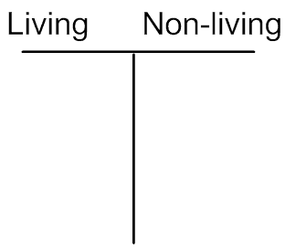

Slide 9
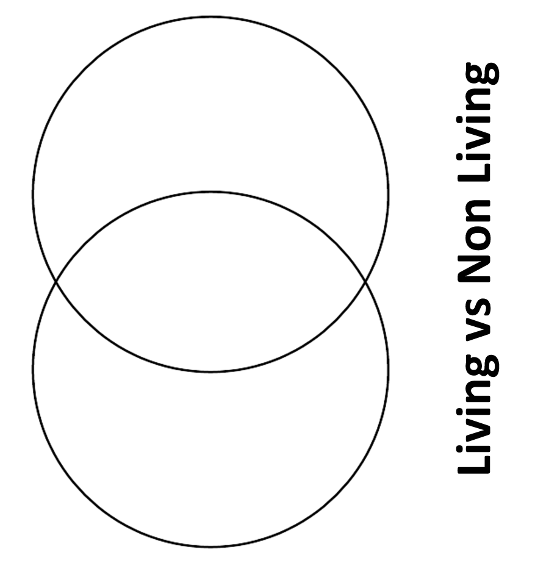
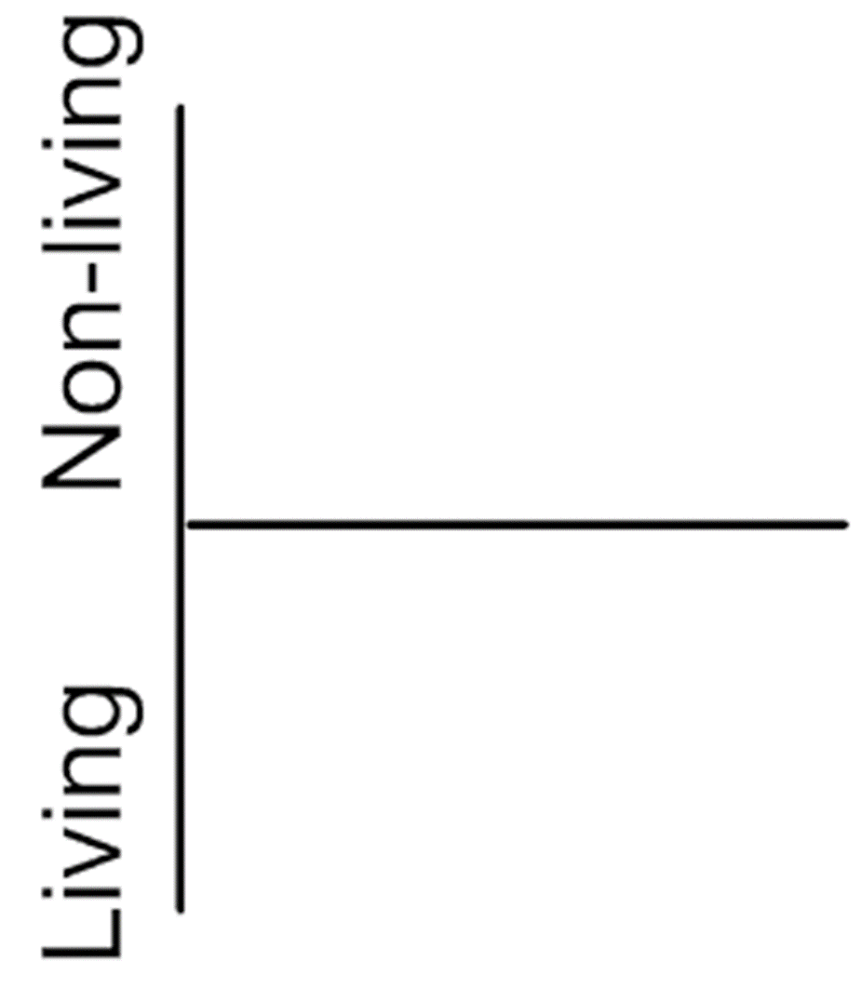

Slide 10
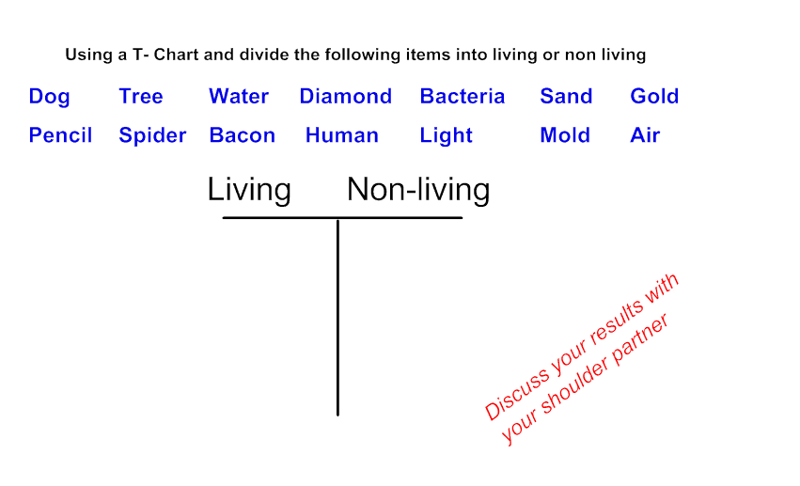

Slide 11
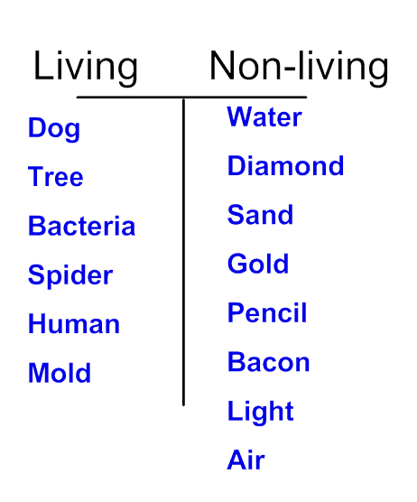
Key

Slide 18
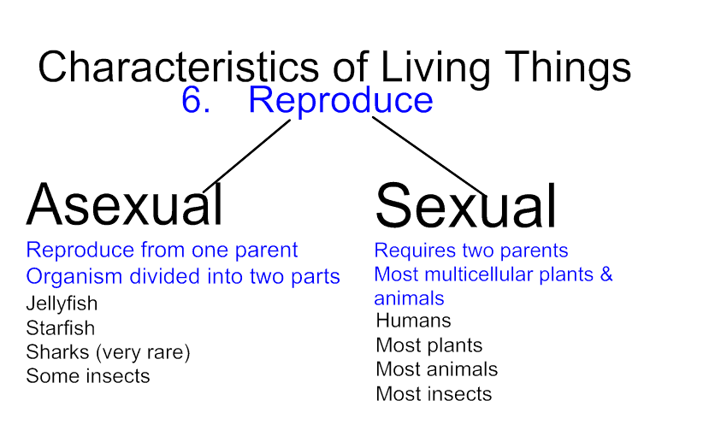

Slide 24
Closure/Exit Ticket/Homework
When given a list of items, several students were confused if they were considered living or non-living. Please chose an item below (or one of your own), then conduct a bit of research online using a credible source. In a short paragraph, give your analysis. Be sure to clearly state if the item is living or non-living and include your reasoning in this conclusion. Your response should also include characteristics and/or properties of living organisms.
Yogurt Pollen Milk Blood
Virus Soil Air Water
Common Core WHST.6-8.7
Conduct short research projects to answer a question (including a self-generated question), drawing on several sources and generating additional related, focused questions that allow for multiple avenues of exploration

Slide 25
http://youtu.be/IPDsRjyuPjw

Slide 26
Show Video

Slide 28
Teacher Notes
In the NGSS practices, teachers are encouraged to have student use the discovery approach rather than a set experiment. The idea of learning through inquiry is the basis for this section.
Teachers should continually circulate during the investigation and ask probing questions?
Guide/steer it the correct direction when needed.
Why do you chose that item?
What makes you think it’s alive/not alive?
Could you try the investigation a different way?

Slide 29
Is it Alive? Name: Life Science Hour:
MS-LS1-1
Science and Engineering Practices:
Planning and Carrying Out an Investigation
As a Scientist, you and your group will be asked to determine if the object in the Petri dish is a living or a non-living organism by planning and carrying out an investigation.
Plan:
Variable/Variables Tested:
Materials needed:
Results/Evidence:
Conclusion:

Slide 30
Teacher Notes
Show the students the event (glue in water)
Add tap water to Petri dish
Place a drop of the glue into the water (hide the label and glue container so the students do not know what it is).
Have them verbally discuss if it alive or not alive.
In groups, students develop a plan to carry out an investigation
If you do this before the unit, have the students apply the various materials with the discovery approach. Pick an item, see if adding it will help determine if it is alive.
After the lesson/unit, apply the concepts (characteristic and needs of living things), then apply these to the investigation.
Does it eat? Add fish food to test
Does it react to heat? Use a heat lamp
Variable – have students discuss the variable and variables tested. Original experiment uses tap water, what happens if we used distilled water. Other possible variables, light source, heat, food…
Materials – Use suggested materials list. Have them available for the students to use. You should also allow students to brainstorm other items to use.
Results: Groups share out to class
Conclusion: Guide students to the conclusion that the object is not alive. Although it moves like a live object, investigation proves that is actually not eating, reproducing….
Is it Alive? Name: Life Science Hour:
MS-LS1-1
Science and Engineering Practices:
Planning and Carrying Out an Investigation
As a Scientist, you and your group will be asked to determine if the object in the Petri dish is a living or a non-living organism by planning and carrying out an investigation.
Plan:
Variable/Variables Tested:
Materials needed:
Results/Evidence:
Conclusion:

Slide 32
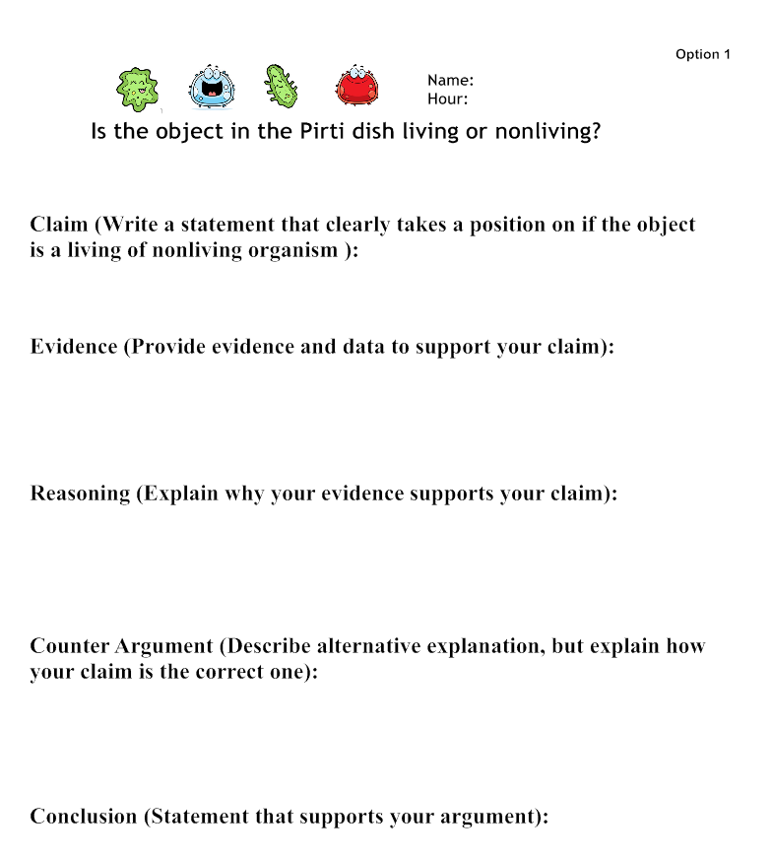

Slide 33
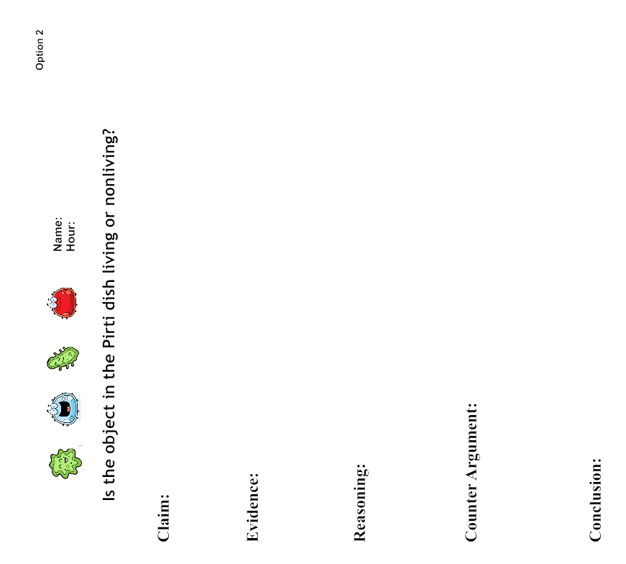

Slide 34
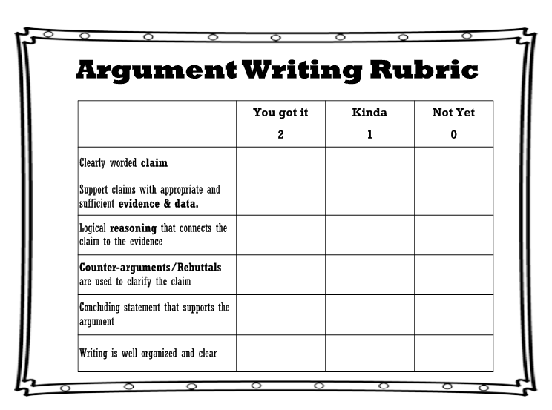
Is it Alive?

