Slide 1
“Twittical" Reading
Using Twitter to teach
Critical Reading/
Guided Highlighted
in the Science Classroom
CCSS and NGSS
4 Ways Polar Bears
Are Dealing
With Climate
Change

Slide 2
MS-ESS2-5.
Collect data to provide evidence for how the motions and complex interactions of air masses results in changes in weather conditions.
MS-ESS2-6.
Develop and use a model to describe how unequal heating and rotation of the Earth cause patterns of atmospheric and oceanic circulation that determine regional climates.
MS-ESS3-5.
Ask questions to clarify evidence of the factors that have caused the rise in global temperatures over the past century.
RST.6-8.1
Cite specific textual evidence to support analysis of science and technical texts. (MS-ESS2-5),(MS-ESS3-5)
RST.6-8.9
Compare and contrast the information gained from experiments, simulations, video, or multimedia sources with that gained from reading a text on the same topic. (MS-ESS2-5)

Slide 3
Notes to Teachers
Twitter is a wonderful source to find current, interesting and FREE articles that can be used with Critical Reading
The most important step is to set up a twitter account for your classroom.
Follow directions at https://twitter.com
My suggestion is to make this a separate account from your personal account.
Make your name something that is unique to you and your classroom (See MsHalseyScience)
Follow reliable sources in the news and science world.
Follow fellow scientist at the local, state and global levels
To find a topic of interest, use the search tool at the top
Skim Twitter periodically and retweet articles to use at later date
Cut, copy, paste and edit the article to fit your classroom needs.
Edit the article to fit your students reading level if needed

Slide 4
What is
Critical Reading?
To the critical reader, any single text provides but one portrayal of the facts, one individual’s “take” on the subject matter. Critical readers thus recognize not only what a text says, but also how that text portrays the subject matter. They recognize the various ways in which each and every text is the unique creation of a unique author.
These three steps or modes of analysis are reflected in three types of reading and discussion:
What a text says – restatement
What a text does – description
What a text means – interpretation
Source: "Reading and Writing Ideas As Well As Words"
Dan Kurland's www.criticalreading.com
http://www.criticalreading.com/critical_reading.htm

Slide 5
Title of Twitter Article: 4 Ways Polar Bears Are Dealing With Climate Change
URL: http://news.nationalgeographic.com/2015/09/150904-polar-bears-dolphins-seals-climate-change/?utm_source=Twitter&utm_medium=Social&utm_content=link_tw20150905news-polarbearsclimate&utm_campaign=Content&sf12802025=1
Source of Tweeted: National Geographic
@NatGeo
on.natgeo.com/1KRNmM0
Date of Tweet: September 5, 2015
Published: Fri Sep 04 12:02:00 EDT 2015
Author: Rachel A. Becker

Slide 6
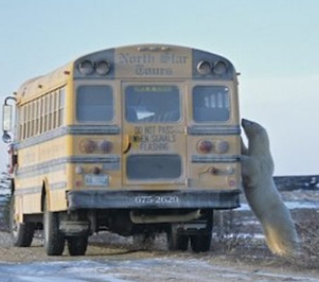
Cue/Opener
Use one of the following video as a dynamic opener
Polar Bear Predation:
http://news.nationalgeographic.com/2015/09/150904-polar-bears-dolphins-seals-climate-change/?utm_source=Twitter&utm_medium=Social&utm_content=link_tw20150905news-polarbearsclimate&utm_campaign=Content&sf12802025=1
State of Polar Bears
http://video.nationalgeographic.com/video/polar-bears
Meet the Polar Bear
https://youtu.be/HnryHZdz4uU
Or
Take a look at the picture
What do you think is
happening?
Why?

Slide 7
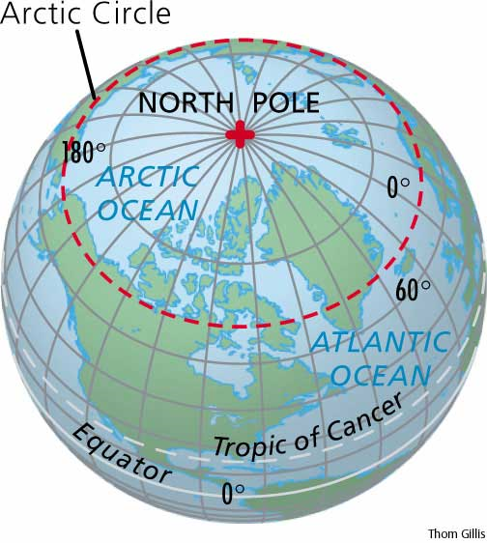
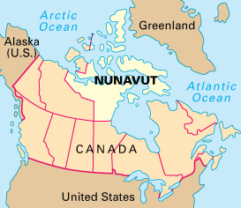
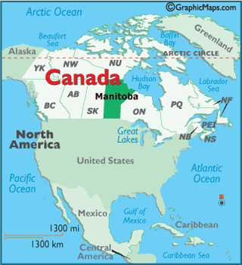
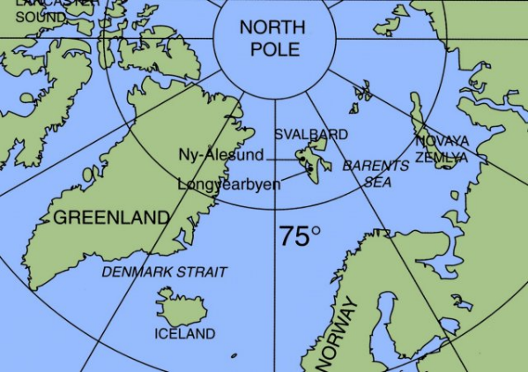
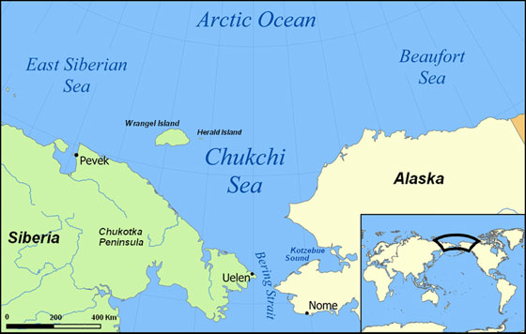
Background
Prior Knowledge
What do we know about
Polar bears
Global warming
Climate change
The Arctic
Some of the cities mentioned
in the article:
Svalbard, Norway
Southern Beaufort Sea
Nunavut Territory, Canada
Churchill, Manitoba

Slide 8
Key Vocabulary
Sea Ice: ice formed by the freezing of seawater : masses of floating ice that have drifted to sea
Predator: an animal that lives by killing and eating other animals : an animal that preys on other animals
Prey: an animal that is hunted or killed by another animal for food
Polar Bears International: the world's leading polar bear conservation organization. Their research, education, and action programs address the issues that are endangering polar bears.
Norwegian Arctic: The land on the Arctic Circle is divided among eight countries: Norway, Sweden, Finland, Russia, the United States (Alaska), Canada, Denmark (Greenland), and Iceland
Surf and Turf: a dish containing both seafood and meat, typically shellfish and steak
Snow geese: a gregarious goose that breeds in Arctic Canada and Greenland, typically having white plumage with black wing tips
Vertebrate zoologist: biological discipline that consists of the study of Vertebrate animals, i.e. animals with a backbone such as fish, amphibians, reptiles, birds and mammals
Population: a group of people or animals of a particular kind that live in a place
Hibernate: to spend the winter sleeping or resting
Forage: food for animals especially when taken by browsing or grazing

Slide 9
Divide by Category
What does the text say?
In paragraph 1, highlight the problem that polar bears face, and how this effects the way they have been acting.
In paragraph 1, highlight the data that discussed by Polar Bear International
In paragraph 2, highlight the scientist’s 10 year plan
In paragraph 3, highlight the strange behavior of the polar bears
In paragraph 4, highlight the likely cause of the strange behavior
In paragraph 7, highlight the alternative food source for polar bears
In paragraph 10, highlight the cause of the food shortage for polar bears
In paragraph 11, highlight the key research discovered about polar bear hibernation
In paragraph 12, highlight the modifications the town of Arviat made during Halloween
In paragraph 13, highlight the text that tells what polar bears will need to do until climate change is under control
How does the text say it?
Highlight the title of the article AND the date it was written
Highlight the name of the periodical that published this article
Highlight around the pictures
Highlight the captions
Between paragraph 2 and 3, highlight the sentence that is bold and italicized
In paragraph 5, highlight the word that is a synonym for benefit or advantage
In paragraph 5, highlight the quotes by Peter Ewins
In paragraph 8, highlight the quotes by Peter Ewins
In paragraph 9, highlight the text that tells the reader who Karyn Rode is
In paragraph 12, highlight the text that tell the reader what a bear banger is
In paragraph 13, highlight the quotes by Peter Ewins
What does the text mean?
Using what you know about ecosystems, what do you predict will happen to the this area due to the change in the polar bears eating habits.
"As Sea Ice Shrinks, Can Polar Bears Survive on Land?“ and "Polar Bears Turning to Goose Eggs to Survive Warming?“ are also article by the National Geographic that discuss the polar bears. Compare and contrast the article to the one we read today.
Look online at the National Geographic “Polar Bear Watch Blog.” Write a blog or a comment to blog.

Slide 10
Divide by Paragraph
Highlight the title of the article AND the date it was written
Highlight the name of the periodical that published this article
Highlight around the pictures
Highlight the captions
In paragraph 1, highlight the problem that polar bears face, and how this effects the way they have been acting.
In paragraph 1, highlight the data that discussed by Polar Bear International
In paragraph 2, highlight the scientist’s 10 year plan
Between paragraph 2 and 3, highlight the sentence that is bold and italicized
In paragraph 3, highlight the strange behavior of the polar bears
In paragraph 4, highlight the likely cause of the strange behavior
In paragraph 5, highlight the word that is a synonym for benefit or advantage
In paragraph 5, highlight the quotes by Peter Ewins
In paragraph 7, highlight the alternative food source for polar bears
In paragraph 8, highlight the quotes by Peter Ewins
In paragraph 9, highlight the text that tells the reader who Karyn Rode is
In paragraph 10, highlight the cause of the food shortage for polar bears
In paragraph 11, highlight the key research discovered about polar bear hibernation
In paragraph 12, highlight the modifications the town of Arviat made during Halloween
In paragraph 12, highlight the text that tell the reader what a bear banger is
In paragraph 13, highlight the text that tells what polar bears will need to do until climate change is under control
In paragraph 13, highlight the quotes by Peter Ewins
What does the text mean?
Using what you know about ecosystems, what do you predict will happen to the this area due to the change in the polar bears eating habits.
"As Sea Ice Shrinks, Can Polar Bears Survive on Land?“ and "Polar Bears Turning to Goose Eggs to Survive Warming?“ are also article by the National Geographic that discuss the polar bears. Compare and contrast the article to the one we read today.
Look online at the National Geographic “Polar Bear Watch Blog.” Write a blog or a comment to blog.

Slide 11
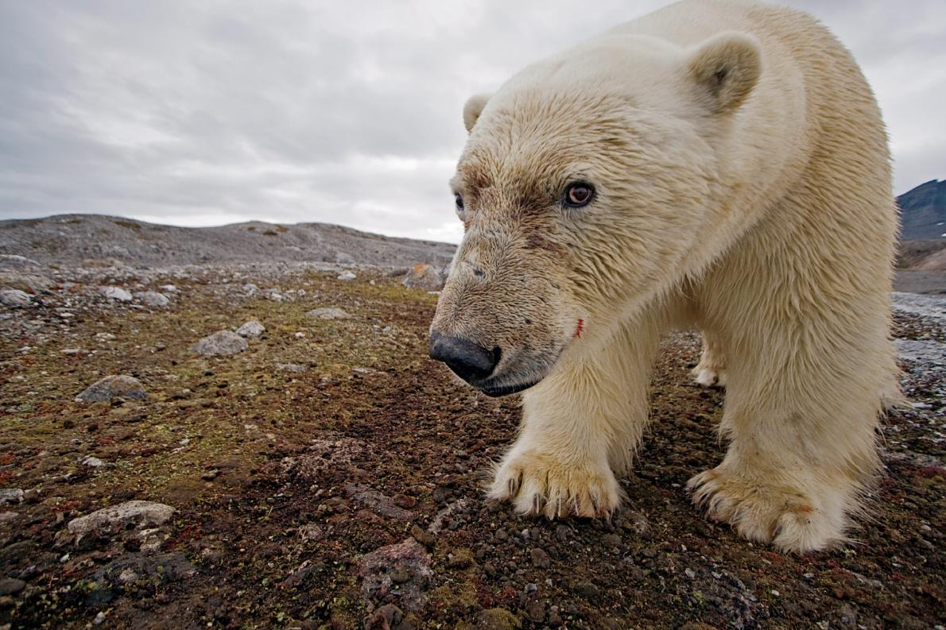
4 Ways Polar Bears Are Dealing With Climate Change
A few of these opportunistic predators have found new sources of food as their regular sources diminish—but is it enough to save them?
Photo: A polar bear examines a camera trap in Svalbard, Norway.
ANSWER KEY
Photograph by Paul Nicklen, National Geographic Creative
By Rachel A. Becker, National Geographic
PUBLISHED Fri Sep 04 12:02:00 EDT 2015
It's a tough time to be a polar bear. The Arctic predators—which depend on constantly diminishing amounts of sea ice to catch marine mammals such as seals—are declining in number, and fast. There are fewer than 25,000 polar bears left in the wild, according to the nonprofit organization Polar Bears International. Near the southern Beaufort Sea, for instance, the population has dropped about 40 percent between 2001 to 2010, from 1,500 to 900 bears. And as their habitat shrinks, they've have been acting strangely. On Wednesday, five bears surrounded a team of scientists at a weather station in Russia, trapping the people inside.
On the same day, elsewhere in the Arctic, scientists representing Canada, Denmark, Norway, Russia, and the United States announced a ten-year plan to prevent polar bears from going extinct. Actions include preserving polar bear habitat and working with policymakers and the public to address climate change. Also this week, President Obama became the first sitting president to visit the U.S. Arctic, traveling through several Alaska cities to highlight threats posed by global warming. But combating climate change doesn't happen overnight, and the lack of food and habitat means polar bears are getting creative to stay alive.
Here are four strategies polar bears are using to weather our changing planet.
Putting Leftovers on Ice
When a research team in Svalbard, a group of islands in the Norwegian Arctic, recently observed a starving polar bear eating a dolphin and burying the leftovers in the snow to save for later, it was surprising on a lot of levels. For one thing, polar bears generally prefer to eat seals. What's more, scientists had never observed the predators eating this species of dolphin. And though other bear species, such as grizzlies, store food for later, sticking leftovers into what amounts to a refrigerator is unusual behavior for polar bears.
1.
2.
3.

Slide 12
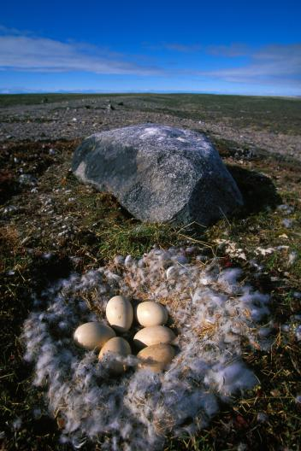
Here's what likely happened: The dolphins swam into Svalbard while it was ice-free—also unusual, since that area is normally frozen year-round. When ice packed into the area later in the year, the dolphins were trapped and fell prey to the polar bear.
These ice entrapments are a short-term boon for the bears, giving them an easy source of fatty food they can just scoop out of a hole in the ice. But Peter Ewins, leader of Arctic conservation for the conservation group WWF, says it doesn't mean Norwegian polar bears will be just fine. “In the long term, the populations of these species of food for the polar bears are going to decline,” he says. “So it’s not going to be a persisting source of high fat for the polar bears.”
Surf and Turf on the Menu
4.
5.
Each year, snow geese come to Canada to breed. Females typically lay four eggs to a clutch. While they were once endangered in the United States, the species has rebounded—which is lucky for polar bears.
In a 2011 study published in the journal Oikos, vertebrate zoologist Robert Rockwell found that these eggs provide a backup food source for the polar bears. Downing one of these eggs is like "eating a stick of butter," Rockwell said in an interview at the time.
While Rockwell estimates that 88 snow goose eggs are about the caloric equivalent of a seal, WWF’s Ewins likens it to eating granola once a day for the summer, and expecting it to sustain you for the next six months. “A few specialist polar bears might be able to eke out a living on a mixture of seaweed, and fish, and whale carcasses that happen to be around” —and, clearly, goose eggs—”but eating those kinds of things doesn’t sustain anything like the current population levels,” Ewins says.
6.
7.
8.
Some polar bears are eating goose eggs (pictured, a clutch in Nunavut Territory, Canada) as it becomes harder for them to catch seals on sea ice.
Photograph by Paul Nicklen, National Geographic Creative

Slide 13
Karyn Rode, a wildlife biologist with the U.S. Geological Survey in Anchorage, Alaska, agrees a few lucky bears could benefit from foods such as goose eggs. But Rode, leader of an April study in the journal Frontiers in Ecology and the Environment on the topic, cautions these opportunistic meals won't help the species as a whole survive. Near Churchill, Manitoba, scientists observed the polar bears' egg diet yielded close to 250,000 calories per week. The bears were also eating some of the birds who laid the yolk-filled meals.
Walking Hibernation? Not So Much
Rising global temperatures and Arctic ice’s natural variability have led to longer annual ice melts in the summer, and incomplete re-freezes in the winter. This makes it harder for the polar bears to find food, since they depend on ice sheets to hunt seals that also use them for rearing pups. “We’re seeing a greater proportion of bears come on shore in the summertime during the sea ice minimum, and they’re spending longer times there,” Rode says.
Some researchers had thought that the polar bears used an active hibernation strategy to conserve energy during lean summer months, when some of them swim ashore. But a study published in July in the journal Science calls that theory into question: The activity trackers the researchers put on the polar bears revealed that the bears didn’t actually slow their metabolic rates beyond the natural slowing caused by starvation.
Eating People Food
Polar bears are "very opportunistic eaters,” Rode says. “They’ll eat anything, and sometimes to their detriment.” That includes the food and waste that people store in their towns. In 2014, the town of Arviat in Nunavut Territory, Canada, had to cancel regular trick- or-treating and hold Halloween indoors due to concerns that children wandering outside would be at risk of a polar bear attack. To reduce polar bear's temptations in Arviat, WWF has been handing out bear-proof metal bins to store food. The nonprofit also hired a polar bear monitor, who uses spotlights and bear bangers—a type of instrument that makes a loud noise—to discourage the bears.
Ewins says that polar bears are going to have to keep adapting as they forage for food. Until climate change is a little more under control, "it’s going to be a few more decades of these problems for animals that are dependent on ice,” he says. “We’re trying to help polar bears and local people survive through that transition.”
9.
10.
11.
12.
13.

Slide 14
4 Ways Polar Bears Are Dealing With Climate Change
A few of these opportunistic predators have found new sources of food as their regular sources diminish—but is it enough to save them?
Photo: A polar bear examines a camera trap in Svalbard, Norway.
Photograph by Paul Nicklen, National Geographic Creative
By Rachel A. Becker, National Geographic
PUBLISHED Fri Sep 04 12:02:00 EDT 2015
It's a tough time to be a polar bear. The Arctic predators—which depend on constantly diminishing amounts of sea ice to catch marine mammals such as seals—are declining in number, and fast. There are fewer than 25,000 polar bears left in the wild, according to the nonprofit organization Polar Bears International. Near the southern Beaufort Sea, for instance, the population has dropped about 40 percent between 2001 to 2010, from 1,500 to 900 bears. And as their habitat shrinks, they've have been acting strangely. On Wednesday, five bears surrounded a team of scientists at a weather station in Russia, trapping the people inside.
On the same day, elsewhere in the Arctic, scientists representing Canada, Denmark, Norway, Russia, and the United States announced a ten-year plan to prevent polar bears from going extinct. Actions include preserving polar bear habitat and working with policymakers and the public to address climate change. Also this week, President Obama became the first sitting president to visit the U.S. Arctic, traveling through several Alaska cities to highlight threats posed by global warming. But combating climate change doesn't happen overnight, and the lack of food and habitat means polar bears are getting creative to stay alive.
Here are four strategies polar bears are using to weather our changing planet.
Putting Leftovers on Ice
When a research team in Svalbard, a group of islands in the Norwegian Arctic, recently observed a starving polar bear eating a dolphin and burying the leftovers in the snow to save for later, it was surprising on a lot of levels. For one thing, polar bears generally prefer to eat seals. What's more, scientists had never observed the predators eating this species of dolphin. And though other bear species, such as grizzlies, store food for later, sticking leftovers into what amounts to a refrigerator is unusual behavior for polar bears.
1.
2.
3.

Slide 15
Here's what likely happened: The dolphins swam into Svalbard while it was ice-free—also unusual, since that area is normally frozen year-round. When ice packed into the area later in the year, the dolphins were trapped and fell prey to the polar bear.
These ice entrapments are a short-term boon for the bears, giving them an easy source of fatty food they can just scoop out of a hole in the ice. But Peter Ewins, leader of Arctic conservation for the conservation group WWF, says it doesn't mean Norwegian polar bears will be just fine. “In the long term, the populations of these species of food for the polar bears are going to decline,” he says. “So it’s not going to be a persisting source of high fat for the polar bears.”
Surf and Turf on the Menu
4.
5.
Each year, snow geese come to Canada to breed. Females typically lay four eggs to a clutch. While they were once endangered in the United States, the species has rebounded—which is lucky for polar bears.
In a 2011 study published in the journal Oikos, vertebrate zoologist Robert Rockwell found that these eggs provide a backup food source for the polar bears. Downing one of these eggs is like "eating a stick of butter," Rockwell said in an interview at the time.
While Rockwell estimates that 88 snow goose eggs are about the caloric equivalent of a seal, WWF’s Ewins likens it to eating granola once a day for the summer, and expecting it to sustain you for the next six months. “A few specialist polar bears might be able to eke out a living on a mixture of seaweed, and fish, and whale carcasses that happen to be around” —and, clearly, goose eggs—”but eating those kinds of things doesn’t sustain anything like the current population levels,” Ewins says.
6.
7.
8.
Some polar bears are eating goose eggs (pictured, a clutch in Nunavut Territory, Canada) as it becomes harder for them to catch seals on sea ice.
Photograph by Paul Nicklen, National Geographic Creative

Slide 16
Karyn Rode, a wildlife biologist with the U.S. Geological Survey in Anchorage, Alaska, agrees a few lucky bears could benefit from foods such as goose eggs. But Rode, leader of an April study in the journal Frontiers in Ecology and the Environment on the topic, cautions these opportunistic meals won't help the species as a whole survive. Near Churchill, Manitoba, scientists observed the polar bears' egg diet yielded close to 250,000 calories per week. The bears were also eating some of the birds who laid the yolk-filled meals.
Walking Hibernation? Not So Much
Rising global temperatures and Arctic ice’s natural variability have led to longer annual ice melts in the summer, and incomplete re-freezes in the winter. This makes it harder for the polar bears to find food, since they depend on ice sheets to hunt seals that also use them for rearing pups. “We’re seeing a greater proportion of bears come on shore in the summertime during the sea ice minimum, and they’re spending longer times there,” Rode says.
Some researchers had thought that the polar bears used an active hibernation strategy to conserve energy during lean summer months, when some of them swim ashore. But a study published in July in the journal Science calls that theory into question: The activity trackers the researchers put on the polar bears revealed that the bears didn’t actually slow their metabolic rates beyond the natural slowing caused by starvation.
Eating People Food
Polar bears are "very opportunistic eaters,” Rode says. “They’ll eat anything, and sometimes to their detriment.” That includes the food and waste that people store in their towns. In 2014, the town of Arviat in Nunavut Territory, Canada, had to cancel regular trick- or-treating and hold Halloween indoors due to concerns that children wandering outside would be at risk of a polar bear attack. To reduce polar bear's temptations in Arviat, WWF has been handing out bear-proof metal bins to store food. The nonprofit also hired a polar bear monitor, who uses spotlights and bear bangers—a type of instrument that makes a loud noise—to discourage the bears.
Ewins says that polar bears are going to have to keep adapting as they forage for food. Until climate change is a little more under control, "it’s going to be a few more decades of these problems for animals that are dependent on ice,” he says. “We’re trying to help polar bears and local people survive through that transition.”
9.
10.
11.
12.
13.

Slide 17
http://visitworldplaces.com/photo/countries/svalbard-and-jan-mayen/05/
www.canada-photos.com
http://visitworldplaces.com/photo/countries/svalbard-and-jan-mayen/05/
http://www.deviantart.com

