Slide 1
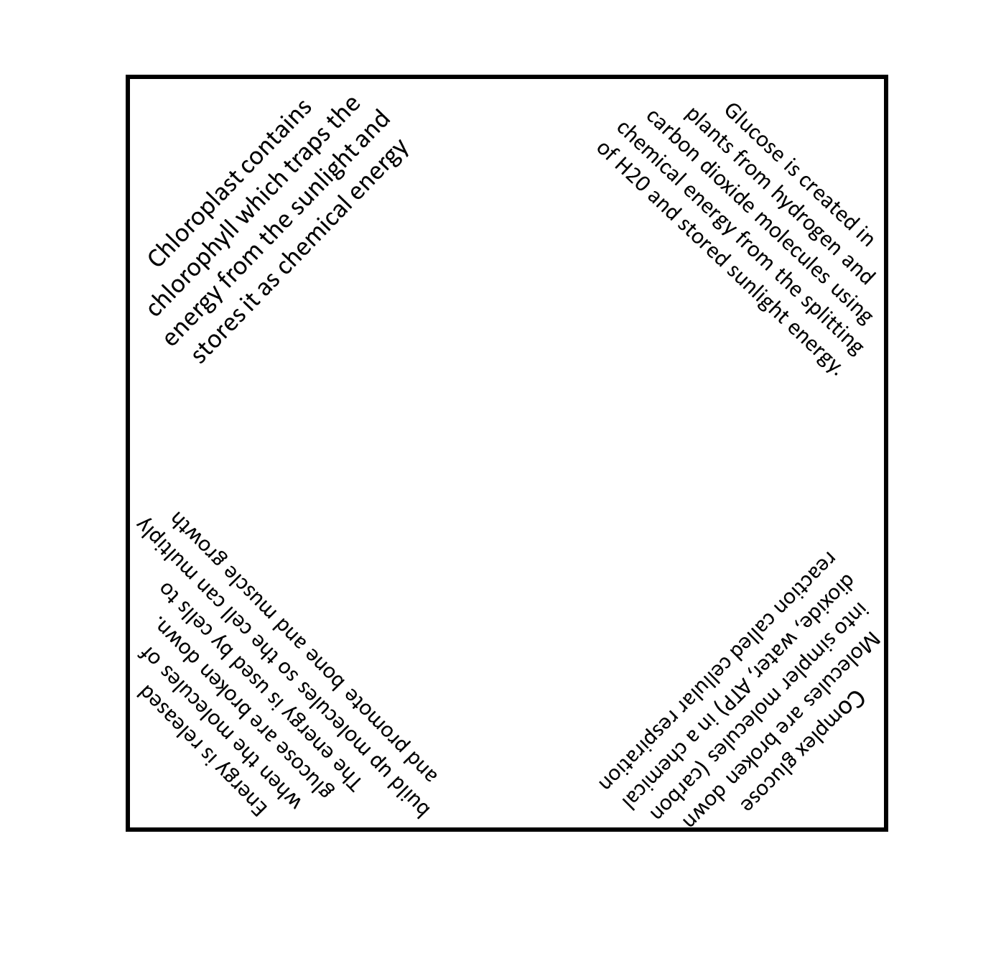
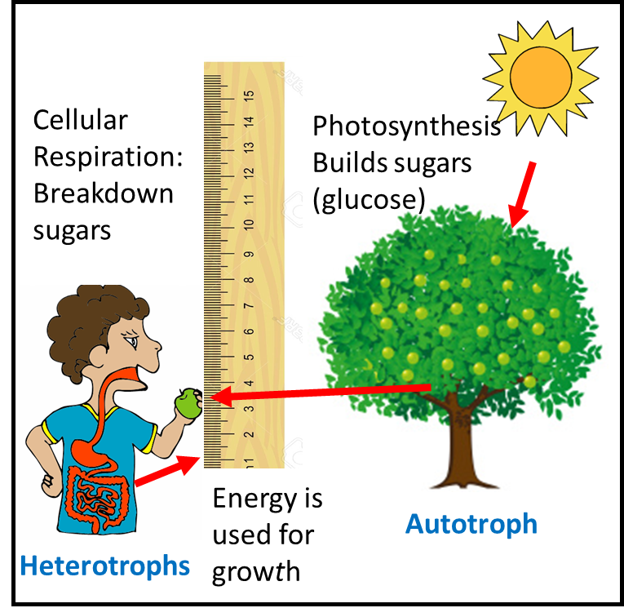
Using a Foldable to Describe Cycle of Matter and Energy in
Organism and Ecosystems
MS LS1-7
SL 8.5
Created
by:
D. Peters

Slide 2
MS LS1-7
Develop a model to describe how food is rearranged through chemical reactions forming new molecules that support growth and/or release energy as this matter moves through an organism. [Clarification Statement: Emphasis is on describing that molecules are broken apart and put back together and that in this process, energy is released.] [Assessment Boundary: Assessment does not include details of the chemical reactions for photosynthesis or respiration.]
Science and Engineering Practices
Developing and Using Models
Modeling in 6–8 builds on K–5 experiences and progresses to developing, using, and revising models to describe, test, and predict more abstract phenomena and design systems.
•Develop a model to describe unobservable mechanisms. (MS-LS1-7)
Disciplinary Core Ideas
LS1.C: Organization for Matter and Energy Flow in Organisms
•Within individual organisms, food moves through a series of chemical reactions in which it is broken down and rearranged to form new molecules, to support growth, or to release energy. (MS-LS1-7)
PS3.D: Energy in Chemical Processes and Everyday Life
•Cellular respiration in plants and animals involve chemical reactions with oxygen that release stored energy. In these processes, complex molecules containing carbon react with oxygen to produce carbon dioxide and other materials. (secondary to MS-LS1-7)
Energy and Matter
• Matter is conserved because atoms are conserved in physical and chemical processes. (MS-LS1-7)
CCSS
SL.8.5
Integrate multimedia and visual displays into presentations to clarify information, strengthen claims and evidence, and add interest. (MS-LS1-7)

Slide 3
Teacher Notes
In my option, the NGSS unit “From Molecules to Organisms: Structure and Processes” has two standards that address photosynthesis and cellular respiration for middle school students. The details of the chemical reactions for photosynthesis and respiration are covered in high school (HS LS2).
MS LS1-6 Covers the role of cycling matter and energy, but not the biochemical mechanism of photosynthesis. It introduces photosynthesis and cellular respiration on a relatively basic level.
MS LS1-7 Takes most of the concepts from MS LS1-6, then guides student to model the process of chemical reactions, molecules and energy. This model describes the unobservable mechanisms such as how food is rearranged through chemical reactions forming new molecules that support growth and release energy as this matter moves through an organism. There is also an emphasis is on describing that molecules are broken apart and put back together where energy is released.
This foldable lesson focuses only on MS LS1-7.
Students will be asked to create a four corner foldable where they can illustrate the concepts. Instructions and sample are included.
SWBAT Develop a model to describe how food is rearranged through chemical reactions forming new molecules that support growth and/or release energy as this matter moves through an organism.

Slide 4
Name:
Use a four corner foldable to model how food is rearranged through chemical reactions forming new molecules that support growth and release energy as this matter moves through an organism.
Outside Corners
Numbered 1-4
Short sentences that describe the process in which organisms get energy (both plants and animals)
Inside Corners
Corresponds with outside corners
Short sentence that describes the chemical reaction of the molecules
Inside Square
Illustration of the process with labels and arrows
Suggested Key Vocabulary
chemical reactions molecules
growth organisms
food sugar (glucose)
Photosynthesis cellular respiration
plants animals
autotrophs heterotrophs
oxygen carbon dioxide
Energy digestive system

Slide 5
Energy from sunlight is captured by chlorophyll in chloroplast.
Energy that has been captures is converted into energy found in food.
Energy is released in the heterotrophs to keep cells healthy and grow new cells.
Heterotrophs eat the plants where it undergoes a chemical reaction in the digestive system.
Sample

Slide 6
Chloroplast contains chlorophyll which traps the energy from the sunlight and stores it as chemical energy
Glucose is created in
plants from hydrogen and
carbon dioxide molecules using
chemical energy from the splitting
of H20 and stored sunlight energy.
Energy is released
when the molecules of
glucose are broken down.
The energy is used by cells to
build up molecules so the cell can multiply
and promote bone and muscle growth
Complex glucose
molecules are broken down
into simpler molecules (carbon
dioxide, water, ATP) in a chemical
reaction called cellular respiration
Sample

Slide 7
Cellular Respiration: Breaks down sugars
Photosynthesis
Builds sugars (glucose)
Energy is used for growth
Autotroph
Heterotrophs
Sample

Slide 8
Printable Template
For Interactive Notebook

Slide 9
Fold from corner to form right triangle
Cut off excess
Fold Triangle in half
Unfold
Fold the corners to the center
Foldable Directions

Slide 10
Credits

