Slide 1
Using a Foldable to Describe That Matter Is Made of
Particles Too Small to be Seen
Created
by:
Diane Peters
5-PS1-1
RI 5.7

Slide 2
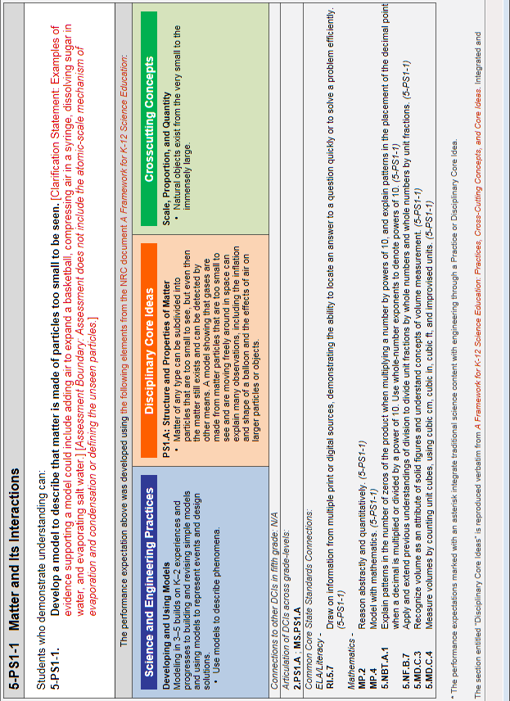

Slide 3
EVIDENCE STATEMENTS
Observable features of the student performance by the end of the grade:
1. Components of the model
a) Students develop a model to describe a phenomenon that includes the idea that matter is made of
particles too small to be seen. In the model, students identify the relevant components for the phenomenon, including:
i. Bulk matter (macroscopic observable matter; e.g., as sugar, air, water).
Particles of matter that are too small to be seen.
2. Relationships
a) In the model, students identify and describe relevant relationships between components, including the relationships between:
Bulk matter and tiny particles that cannot be seen (e.g., tiny particles of matter that cannot be seen make up bulk matter).
The behavior of a collection of many tiny particles of matter and observable phenomena involving bulk matter (e.g., an expanding balloon, evaporating liquids, substances that dissolve in a solvent, effects of wind).
3. Connections
a) Students use the model to describe how matter composed of tiny particles too small to be seen can account for observable phenomena (e.g., air inflating a basketball, ice melting into water).

Slide 4
Teacher Notes
Students will be asked to create a four corner foldable where they can illustrate the concepts. Instructions and sample are included.
SWBAT Develop a model to describe that matter is made of particles too small to be seen.
A Framework for K-12 Science Education: Practices, Crosscutting Concepts, and Core Ideas ( 2012 )
http://www.nap.edu/openbook.php?record_id=13165&page=108
By the end of grade 5.
Matter of any type can be subdivided into particles that are too small to see, but even then the matter still exists and can be detected by other means (e.g., by weighing or by its effects on other objects). For example, a model showing that gases are made from matter particles that are too small to see and are moving freely around in space can explain many observations, including the inflation and shape of a balloon; the effects of air on larger particles or objects (e.g., leaves in wind, dust suspended in air); and the appearance of visible scale water droplets in condensation, fog, and, by extension, also in clouds or the contrails of a jet. The amount (weight) of matter is conserved when it changes form, even in transitions in which it seems to vanish (e.g., sugar in solution, evaporation in a closed container). Measurements of a variety of properties (e.g., hardness, reflectivity) can be used to identify particular materials. (Boundary: At this grade level, mass and weight are not distinguished, and no attempt is made to define the unseen particles or explain the atomic-scale mechanism of evaporation and condensation.)
Disciplinary Core Ideas
PS1.A: Structure and Properties of Matter
•Matter of any type can be subdivided into particles that are too small to see, but even then the matter still exists and can be detected by other means. A model showing that gases are made from matter particles that are too small to see and are moving freely around in space can explain many observations, including the inflation and shape of a balloon and the effects of air on larger particles or objects. (5-PS1-1)

Slide 5
Macroscopic vs Microscopic
Matter can be categorized as either macroscopic or microscopic. Macroscopic or bulk matter, describes matter which is large enough to see, handle, manipulate, weigh, etc. Microscopic matter describes particles of matter that are too small to be seen. All matter can be subdivided into microscopic particles that are too small to see, and microscopic particles can be made visible when we observe a phenomenon, behaviors or a collection of these microscopic particles.
Although we can not see microscopic matter, we know that it exists because we can be detected by other means. For example, an inflated balloon has gas particles that helps the balloon maintain it’s shape. We can not see these gas particles inside the balloon, but we know they exist because the balloon is inflated. On a windy fall day, we will not see the microscopic air particles, but we know they exist when we observe the leaves moving. This observable phenomena indicated that matter exists.
The behavior of many tiny particles of matter also indicated the existence of matter. I know there are water molecules in the air, but I can not see them, as they are microscopic. When I leave a cold glass of water outside on a warm day, the water molecules collect or condenses on the outside of my glass. Because of the behavior of the water molecules, I am now able to see the macroscopic matter.
In other instances, tiny microscopic particles combine so the bulk matter is visible. When microscopic particles in the air collect together, we can see them in the macroscopic form of a cloud.
Remember, matter is anything which has real physical existence; in a word matter is just stuff. Iron, air, wool, gold, milk, zebras and pizza - these are all matter. Some things which are not matter are heat, cold, colors, dreams hopes, ideas, sunlight, beauty, fear, and x-rays. None of these is "stuff"; none is matter. Matter can be divide into microscopic and macroscopic particles. No matter how small or large the particles, it is still matter.
Source: “What is Chemistry?” John B. Russell, General Chemistry, McGraw-Hill International Book Company, 2001 http://chemweb.ucc.ie

Slide 6
Name:
Use the center foldable to model to describe that matter is made of particles too small to be seen.
Outside Flaps
Labeled
Microscopic
Macroscopic
Inside Flap
Define
Microscopic
Macroscopic
Inside Square
Illustration of the matter in both microscopic and macroscopic form with labels.
Brief sentence of how the matter is observable due to the phenomenon or behavior
Suggested Matter
Water that evaporates Clouds
Water that condenses Fog
Air inside of balloon Air in a bike tire
Jet stream across the sky Air in a basketball
Sugar dissolves in water Salt water

Slide 7
Sample
Macroscopic
Microscopic

Slide 8
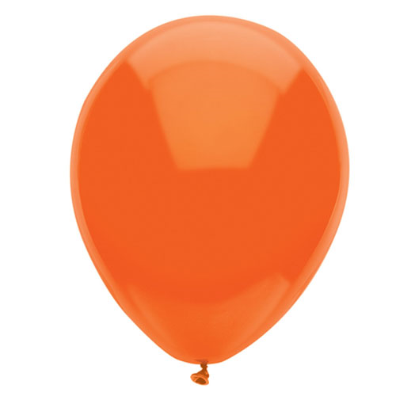
Sample
Macroscopic or bulk matter, describes matter which is large enough to see, handle, manipulate, weigh, etc. All matter can be subdivided into particles that are too small to see
Matter: Air in a balloon
Microscopic matter describes particles of matter that are too small to be seen. Microscopic particles can be made visible when we observe a phenomenon, behaviors or a collection of these microscopic particles.
Microscopic: Air around us
Macroscopic: We observe the inflated balloon, so we know there is air inside the balloon

Slide 9
Printable Template for Interactive Notebook

Slide 10
Printable Template for Interactive Notebook
Macroscopic
Microscopic

Slide 11
Fold paper in half
Fold side edges to the center line
Foldable Directions

