Slide 1
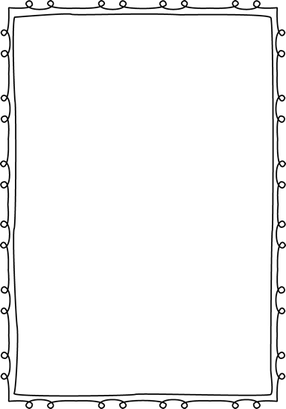
Introducing the Engineering Design
Hands On Activity
Science Opener
Team Builder
Mrs. Peters
NGSS
3-5-ETS1-1
3-5-ETS1-2
3-5-ETS1-3
CCSS
ELA RI.5.1
ELA RI.5.7
ELA RI.5.9

Slide 2
3-5 EST 1-1
Define a simple design problem reflecting a need or a want that includes specified criteria for success and constraints on materials, time, or cost.
Science and Engineering Practices
Asking questions and defining problems in 3–5 builds on grades K–2 experiences and progresses to specifying qualitative relationships.
•Define a simple design problem that can be solved through the development of an object, tool, process, or system and includes several criteria for success and constraints on materials, time, or cost. (3-5-ETS1-1)
Disciplinary Core Ideas
ETS1.A: Defining and Delimiting Engineering Problems
•Possible solutions to a problem are limited by available materials and resources (constraints). The success of a designed solution is determined by considering the desired features of a solution (criteria). Different proposals for solutions can be compared on the basis of how well each one meets the specified criteria for success or how well each takes the constraints into account. (3-5-ETS1-1)
Crosscutting Concepts
Influence of Science, Engineering, and Technology on Society and the Natural World
•People’s needs and wants change over time, as do their demands for new and improved technologies. (3-5-ETS1-1)
CCSS ELA
W.5.7: Conduct short research projects that use several sources to build knowledge through investigation of different aspects of a topic. (3-5-ETS1-1),(3-5-ETS1-3)
W.5.8: Recall relevant information from experiences or gather relevant information from print and digital sources; summarize or paraphrase information in notes and finished work, and provide a list of sources. (3-5-ETS1-1),(3-5-ETS1-3)
W.5.9: Draw evidence from literary or informational texts to support analysis, reflection, and research. (3-5-ETS1-1),(3-5-ETS1-3)
CCSS Mathematics -
3.OA: Operations and Algebraic Thinking (3-ETS1-1),(3-ETS1-2)
MP.2: Reason abstractly and quantitatively. (3-5-ETS1-1),(3-5-ETS1-2),(3-5-ETS1-3)
MP.4: Model with mathematics. (3-5-ETS1-1),(3-5-ETS1-2),(3-5-ETS1-3)
MP.5: Use appropriate tools strategically. (3-5-ETS1-1),(3-5-ETS1-2),(3-5-ETS1-3)
3-5.OA: Operations and Algebraic Thinking (3-ETS1-1),(3-ETS1-2)

Slide 3
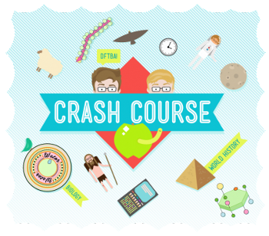
Lesson Opener:
What’s an Engineer?
Assess prior knowledge
Brainstorm
Partner share
https://youtu.be/owHF9iLyxic
Crash Course Kids #12.1
Engineer
Someone who wants to know how and why things work.
A person who designs and builds things to solve specific problems
3 Very important questions engineers ask
1. What is the problem that needs to be solved
2. Who has the problem that need to be solved
3. Why is this problem important to solve?
Types of Engineers:
Civil Chemical
Electrical Computer
Software Nuclear
Aerospace Mechanical
No matter what kind of engineer someone is, their job at its most basic level is problem-solving. Each engineer just specializes in solving certain kinds of problems

Slide 4
What’s an Engineer?
Name:
What do YOU think an Engineer is? What do they do?
Engineer______________________________________________
_______________________________________________________________________________________________________________________________________________________________
3 Very important questions engineers ask
1. _______________________________
2. _______________________________
3. _______________________________
Types of Engineers:
No matter what kind of engineer someone is, their job at its most basic level is ___________________________.
Each engineer just specializes in __________________ certain kinds of problems.

Slide 5
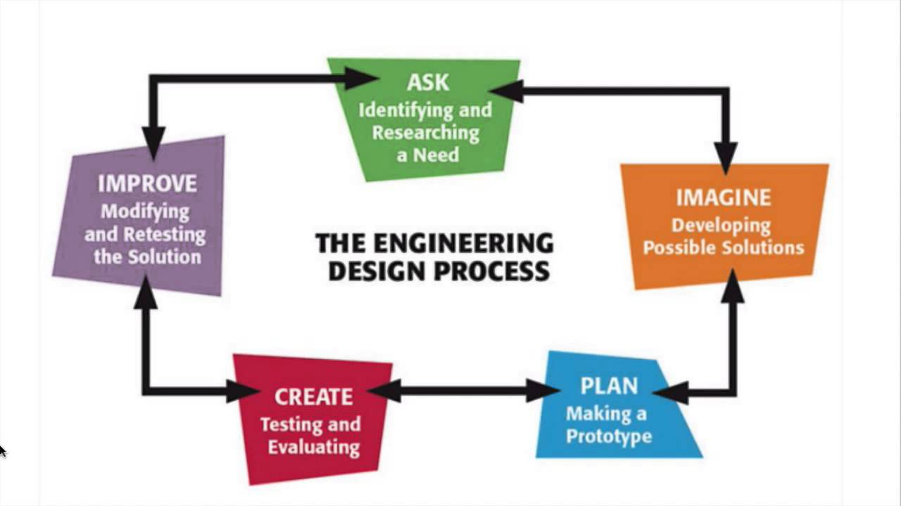
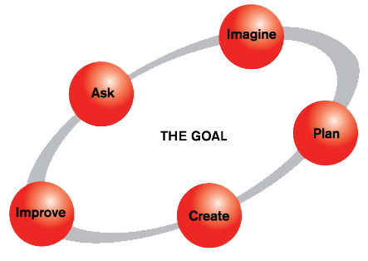
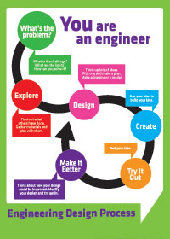
Graphic Representation
Of
Engineering Process
Teacher notes: There are numerous graphic models of
the engineering process.
Use one of these, or modify to make your own (see next slide).

Slide 6
Engineering Process
The series of steps that all engineers follow when they are trying to solve a problem
What is the problem? Define the problem. What are your constraints?
Explore: Do your research. How have other approached the problem? What materials are available.
Develop a possible solution.
Design: Use your imagination to develop possible solutions. Choose one idea and draw a diagram.
Create: Follow your plan to create your prototype
Try it Out: Test your solution
Make it better: Evaluate/Improve: Look at what worked and what didn’t. Return to steps of engineering design process.

Slide 8
NGSS: 3-5 EST 1-1
Paper Table
Name:
On no! You're stuck at a paper recycling plant and have no place to do your homework. Follow the challenge below using the engineering design process.
Your Challenge
Design and build a table out of newspaper. Make it at least eight inches tall and strong enough to hold a heavy book.
Materials (per group)
1 piece of cardboard (8 1/2 x 11 inches)
textbook
masking tape (1 roll per group)
8 sheets of newspaper (full sheets, not half)
ruler
What is the problem? What are your constraints?
Do your research by exploring using online sources. How have other approached the problem? What materials are available.
Brainstorm with your group and develop a possible solution. List your ideas below.
Modified from: http://pbskids.org/designsquad/parentseducators/resources/paper_table.html

Slide 9
Paper Table
Name:
Design: Use your imagination to develop possible solutions. List the solutions in space below. Choose one idea and draw a diagram on a separate sheet of paper.
Create: Follow your plan to create your prototype
Try it Out: Test your solution. What worked? What didn’t work? How many books did it hold?
Make it better: Looking at what worked and what didn’t, how do you plan to make it better? What step do you need to revisit in the engineering design process.
Modified from: http://pbskids.org/designsquad/parentseducators/resources/paper_table.html

Slide 10
Teachers Guide
Paper Table
On no! You're stuck at a paper recycling plant and have no place to do your homework. Follow the challenge below using the engineering design process.
Your Challenge
Design and build a table out of newspaper. Make it at least eight inches tall and strong enough to hold a heavy book.
Materials (per group)
1 piece of cardboard (8 1/2 x 11 inches)
a textbook
masking tape (1 roll per group)
8 sheets of newspaper (full sheets, not half)
Ruler
1. What is the problem? You have no place to do your homework, so you need to make a table of newspapers to hold textbooks.
What are your constraints? You can only use 8 sheets of newspaper. 1 roll of masking tape, and one piece of cardboard. Also, the table must be at least eight inched tall and hold a textbook.
2. Do your research by exploring online sources. See “Research Assignment for Common Core” for alternate activities
How have other approached the problem?
Allow students to look around at similar tables or workspaces. Online sources are
encouraged as well as having students take photographs and possible link to a classroom website, Instagram or Twitter.
BrainPop also has a wonderful link for Engineering and Tech called “Building Basics” and “Bridges” that you may find helpful.
What materials are available.
1 piece of cardboard (8 1/2 x 11 inches)
a textbook
masking tape (1 roll per group)
8 sheets of newspaper (full sheets, not half)
Ruler
3. Brainstorm with your group and develop a possible solution. List your ideas below. Leading questions
1. How can you make a strong tube out of a piece of newspaper? (This challenge uses tubes because it takes more force to crumple paper when it's shaped as a tube.)
2.How can you arrange the tubes to make a strong, stable table?
3.How can you support the table legs to keep them from tilting or twisting?
4.How level and big does the table's top need to be to support a heavy book?
Modified from: http://pbskids.org/designsquad/parentseducators/resources/paper_table.html

Slide 11
Paper Table
Name:
Design: Use your imagination to develop possible solutions. List the solutions in space below. Choose one idea and draw a diagram on a separate sheet of paper. This is a great time for students to work together as a team. Use this activity to set the tone for future group activities. Roles, rules, expectations and procedures should be established.
Create: Follow your plan to create your prototype. Students should have establish roles in building the design. There should not be two designs built at the same time. Teacher needs to circulate to encourage thinking like an engineer.
Try it Out: Test your solution. What worked? What didn’t work? How many books did it hold? Be sure that students write down the answer to these questions. I would suggest having students share results.
Make it better: Looking at what worked and what didn’t, how do you plan to make it better? What step do you need to revisit in the engineering design process. My suggestion is to make this a multiple day project. Students NEED to learn from their mistakes. BUT they need to make sure they have a plan. Allow time before building to redesign their plan. See suggested discussion items from Design Squad:
“When you test, your design may not work as planned. If things don't work out, it's an opportunity—not a mistake! When engineers solve a problem, they try different ideas, learn from mistakes, and try again. Study the problems and then redesign. For example, if:
•the tubes start to unroll—Re-roll them so they are tighter. A tube shape lets the load (i.e., the book) push on every part of the paper, not just one section of it. Whether they're building tables, buildings, or bridges, load distribution is a feature engineers think carefully about.
•the legs tilt or twist—Find a way to stabilize and support them. Also check if the table is lopsided, too high, or has legs that are damaged or not well braced.
•a tube buckles when you add weight—Support or reinforce the weak area, use a wider or thicker-walled tube, or replace the tube if it's badly damaged. Changing the shape of a material affects its strength. Shapes that spread a load well are strong. Dents, creases, and wrinkles that put stress on some areas more than others make a material weaker.
•the table collapses—Make its base as sturdy as possible. Also, a table with a lot of triangular supports tends to be quite strong. A truss is a large, strong support beam. It is built from short boards or metal rods that are arranged as a series of triangles. Engineers often use trusses in bridges, buildings, and towers.”
Modified from: http://pbskids.org/designsquad/parentseducators/resources/paper_table.html

Slide 12
Research Assignment for Common Core
CCSS ELA
W.5.7: Conduct short research projects that use several sources to build knowledge through investigation of different aspects of a topic. (3-5-ETS1-1),(3-5-ETS1-3)
W.5.8: Recall relevant information from experiences or gather relevant information from print and digital sources; summarize or paraphrase information in notes and finished work, and provide a list of sources. (3-5-ETS1-1),(3-5-ETS1-3)
W.5.9: Draw evidence from literary or informational texts to support analysis, reflection, and research. (3-5-ETS1-1),(3-5-ETS1-3)
To ensure that you build the best Paper Table possible, you need to follow the Engineering Process and EXPLORE.
Like an engineer, you will need to do some research. Using online or text sources write a short writing assignment answering the following questions:
How have other approached the problem?
What are some successful table designs?
What experience do you have with building? Were you successful?
How will this research change your design plan?
What sources did you use for your research?

Slide 14
3-5 ETS1-2 Generate and compare multiple possible solutions to a problem based on how well each is likely to meet the criteria and constraints of the problem.
Science and Engineering Practices
Constructing Explanations and Designing Solutions
Constructing explanations and designing solutions in 3–5 builds on K–2 experiences and progresses to the use of evidence in constructing explanations that specify variables that describe and predict phenomena and in designing multiple solutions to design problems.
•Generate and compare multiple solutions to a problem based on how well they meet the criteria and constraints of the design problem. (3-5-ETS1-2)
Disciplinary Core Ideas
ETS1.B: Developing Possible Solutions
•Research on a problem should be carried out before beginning to design a solution. Testing a solution involves investigating how well it performs under a range of likely conditions. (3-5-ETS1-2)
•At whatever stage, communicating with peers about proposed solutions is an important part of the design process, and shared ideas can lead to improved designs. (3-5-ETS1-2)
Cross Cutting Concepts
•Engineers improve existing technologies or develop new ones to increase their benefits, decrease known risks, and meet societal demands. (3-5-ETS1-2)
Common Core State Standards Connections:
ELA/Literacy -
RI.5.1: Quote accurately from a text when explaining what the text says explicitly and when drawing inferences from the text. (3-5-ETS1-2)
RI.5.1: Draw on information from multiple print or digital sources, demonstrating the ability to locate an answer to a question quickly or to solve a problem efficiently. (3-5-ETS1-2)
RI.5.9: Integrate information from several texts on the same topic in order to write or speak about the subject knowledgeably. (3-5-ETS1-2)
Mathematics -
3.OA: Operations and Algebraic Thinking (3-ETS1-1),(3-ETS1-2)
MP.2: Reason abstractly and quantitatively. (3-5-ETS1-1),(3-5-ETS1-2),(3-5-ETS1-3)
MP.4: Model with mathematics. (3-5-ETS1-1),(3-5-ETS1-2),(3-5-ETS1-3)
MP.5: Use appropriate tools strategically. (3-5-ETS1-1),(3-5-ETS1-2),(3-5-ETS1-3)
3-5.OA: Operations and Algebraic Thinking (3-ETS1-1),(3-ETS1-2)

Slide 15
Teacher Notes
In the “Paper Table” activity, students generated multiple possible solutions to a problem. Students should share their results with their peers which would allow them to compare their solutions. As they share , peers analyze how well meet the criteria and constraints of the problem.
While groups present their paper table:
Summarize the research they used
Discuss their test of the table. How well did it perform?
What changes did they make?
Group Feedback:
How could this group improve their design?
Paper Table
Engineering Design
Group Members:
Peer Feedback:
How well did they meet the criteria and constraints of the problem?
Was their research helpful?
How well did it perform?
How could this group improve their design?
Name:

Slide 16
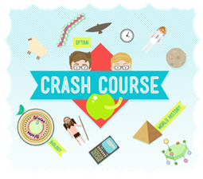
Alternate Activity
3-5 ETS1-2 Generate and compare multiple possible solutions to a problem based on how well each is likely to meet the criteria and constraints of the problem.
Think back to the opening video…
What is an Engineer?
Someone who wants to know how and why things work.
A person who designs and builds things to solve specific problems
What are the 3 Very important questions engineers ask?
1. What is the problem that needs to be solved
2. Who has the problem that need to be solved
3. Why is this problem important to solve?
Think back to the section on the Golden Gate Bridge
What was the problem: People could not travel in and out of San Francisco without a boat
Who had the problem: People traveling in and out of San Francisco
Why was this problem important to solve? It was difficult and time consuming for people to travel in and out of the city.
OPTION #1:
Think of a problem that surrounds your school, city, state, that allows students to identify the “3 very important questions.” Students generate possible solutions to the problem. This need to be ONE problem, where the students can compare each others solutions on how well it meets the criteria and constraints of the problem.
OPTION #2
Have students play the “Mission Impossible” game in the gym. Identify the “3 very important questions,” then generate solutions in groups. In the Mission Impossible game, students needed to figure out a way to cross a raging river (the gym floor) using a variety of PE equipment (hula-hoop, balance beam…) . The students has the task of moving all of their different types of gym equipment, then all of their group members across the river without touching the water. See https://youtu.be/t6Zr1Z09Xtw for visual. Each group will follow the engineering process, then compare each others solutions on how well it meets the criteria and constraints of the problem.
Review the opening video “What is an Engineer?”

Slide 17
3-5-ETS1-3.
Plan and carry out fair tests in which variables are controlled and failure points are considered to identify aspects of a model or prototype that can be improved.
Planning and Carrying Out Investigations
Planning and carrying out investigations to answer questions or test solutions to problems in 3–5 builds on K–2 experiences and progresses to include investigations that control variables and provide evidence to support explanations or design solutions.
•Plan and conduct an investigation collaboratively to produce data to serve as the basis for evidence, using fair tests in which variables are controlled and the number of trials considered. (3-5-ETS1-3)
Disciplinary Core Ideas
ETS1.B: Developing Possible Solutions
•Tests are often designed to identify failure points or difficulties, which suggest the elements of the design that need to be improved. (3-5-ETS1-3)
ETS1.C: Optimizing the Design Solution
•Different solutions need to be tested in order to determine which of them best solves the problem, given the criteria and the constraints. (3-5-ETS1-3)
CCSS ELA
W.5.7: Conduct short research projects that use several sources to build knowledge through investigation of different aspects of a topic. (3-5-ETS1-1),(3-5-ETS1-3)
W.5.8: Recall relevant information from experiences or gather relevant information from print and digital sources; summarize or paraphrase information in notes and finished work, and provide a list of sources. (3-5-ETS1-1),(3-5-ETS1-3)
W.5.9: Draw evidence from literary or informational texts to support analysis, reflection, and research. (3-5-ETS1-1),(3-5-ETS1-3)

Slide 18
Teacher Notes
3-5-ETS1-3
Opener: Use informational text article - “What is an Investigation?” to introduce the concept of controlled variable.
In our paper table activity were the variable controlled? No – Students may have uses addition amounts of tape, less cardboard or not all 8 sheets of newspaper. How can we make them into a controlled variable? Lead students to redo the criteria with specific controlled variables. Example: 1 meter of masking tape, must uses all 8 sheets of paper, cardboard must be specific size…
Allow students to plan and carry out fair tests in which variables are controlled and failure points are considered to identify aspects of a model or prototype that can be improved in additional trials.
In a whole class discussion, decide on 4 design types that worked the best to conduct a collaborative investigation.
Review and reinforce the variables and constrains of the design
Conduct a fair test (with optional numerous trials )
Produce and record your data for evidence.
Determine which design best solves the problem with the given criteria and constraints.

Slide 19
What is an Investigation?
Investigations are one way to answer questions. If you ask "How long does it take for an ice cube to melt?", you can do an investigation to find out. Take an ice cube out the freezer, put it in a bowl on the counter and time how long it takes to melt. That's the simplest type of investigation where you are watching a phenomenon.
That basic investigation can lead to more questions and more advanced investigations. After watching the ice cube melt, most kids will start to ask more questions. What could we have done to make the ice cube melt faster? What would make it melt slower? To solve this, you can set up a series of tests.
Let’s define a few of the terms you will need to investigate.
Independent Variable - something that is changed in the experiment.
Dependent Variable - something that responds to the Independent variable.
Controlled Variable - something that is kept the same throughout the series of experiments.
Control - similar test where the independent variable is left unchanged to provide a comparison.
To continue with our ice cube melting investigation, the next question might be "Would the ice cube melt faster if it was in little pieces?" You could set-up a test where you have one ice cube that is broken into little pieces on one plate, and a whole ice cube on a plate beside it. Then you would time how long it takes each ice cube to turn into water.
The independent variable is the size of the pieces of ice, it changed between the two tests. One of the constant variables would be the temperature in the room, it stays the same for both tests. The control would be the whole ice cube that is melting. The dependent variable would be the time it takes the ice cube to melt. That variable is dependent on the size of the pieces of ice.
What if you had just taken out one ice cube, broken it into small pieces and timed how long it took to melt? Couldn't you have just compared it to the time it took the first ice cube to melt? Maybe. But the temperature in the room might have changed between the two investigations. By having a control (the whole ice cube) you are trying to control for other variables that aren't part of the investigation (temperature) but that could change your results.
If your planning a series of investigations, the controlled variable could become the independent variable in the next investigation. It just depends on the question you are trying to answer and the design of the investigation. A control is often the most interesting part of the investigation. Often they will surprise the scientist by behaving different from what was expected.
Modified from http://www.sciencekidsathome.com/science_fair/what_is_an_experiment.html

Slide 20
Name:
What is a controlled variable?
In our paper table activity were ALL the variable controlled?
How can we make them into a controlled variable?
Which design best solves the problem and follows the guidelines?
Design | Trial #1 | Trial #2 | Trial #3
1.
2.
3.
4.

Slide 21
The Engineering Process
Unit Closer
The Engineering Process: Crash Course Kids #12.2
https://youtu.be/fxJWin195kU
Engineering Process
The series of steps that all engineers follow when they’re trying to solve a problem.
What is the Engineering Process?
What is the problem? Define the problem. What are your constraints?
Explore: Do your research. How have other approached the problem? What materials are available.
Develop a possible solution
Design your solution: Use your imagination to develop possible solutions. Choose one idea and draw a diagram.
Create: Follow your plan to create your build a prototype
Try it Out: Test it your solution
Make it better: Evaluate your solutions /Improve: Look at what worked and what didn’t. Return to steps of engineering design process.

Slide 22
Name:
The Engineering Process
What is the Engineering Process?__________________________
_______________________________________________________________________________________________________________________________________________________________
What are the steps of the Engineering Process?
1. _______________________________
2. _______________________________
3. _______________________________
4. _______________________________
5. _______________________________
6. _______________________________
7. _______________________________
Pick an Engineer from the video, identify the problem and solution.
Inventor:
Problem:
Solution:

Slide 23
Name:
Do You Think Like an Engineer?
Take the online quiz below to find out if you think like an engineer.
Choose the answer that best fits your experiences.
The results will show you what kind of engineer you might be.
http://www.doyouthinklikeanengineer.com/quiz/
You might have an engineering brain and not even know it.
So tell us in complete sentences.
Do you think like an engineer?
What type of Engineer did the quiz predict you to be?
Do you agree? Why or why not?

Slide 24
Credits
http://pbskids.org/designsquad/parentseducators/resources/paper_table.html
http://www.doyouthinklikeanengineer.com/quiz/

