Slide 1
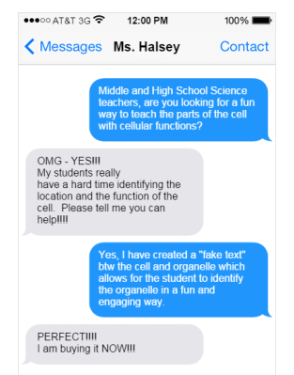
Mrs. Peters
Who sent the Text Message?
Match the Message to the Organelle
"Cellular" Message
MS-LS1-2
Develop and use a model to describe the function of a cell as a whole and ways parts of cells contribute to the function.

Slide 2
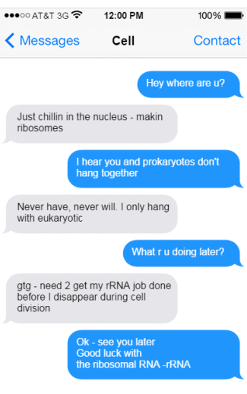
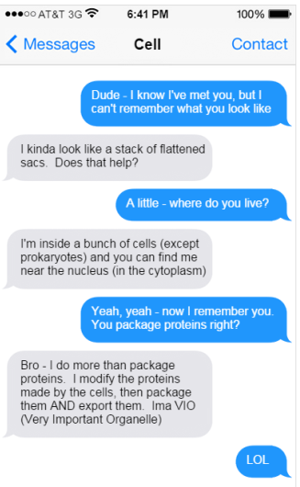
Name:
“Cellular” Message
Identify the organelle in the text message
Who am I?
1.__________________
Who am I?
2.__________________

Slide 3
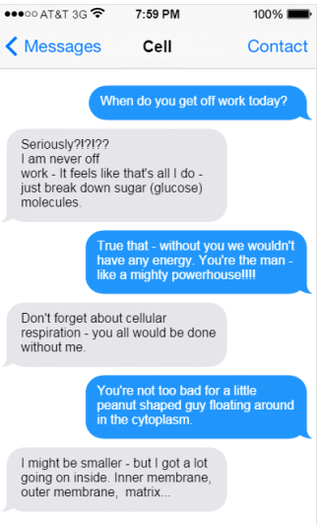
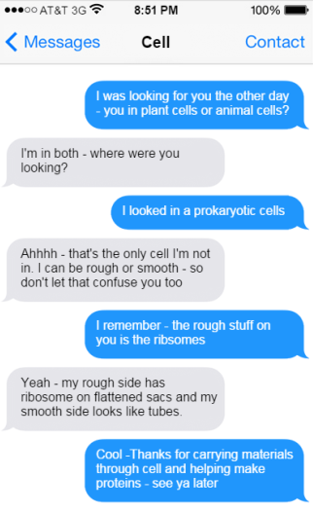
Who am I?
3.__________________
Who am I?
4.__________________

Slide 4
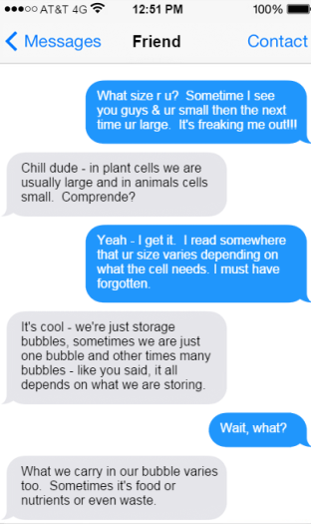
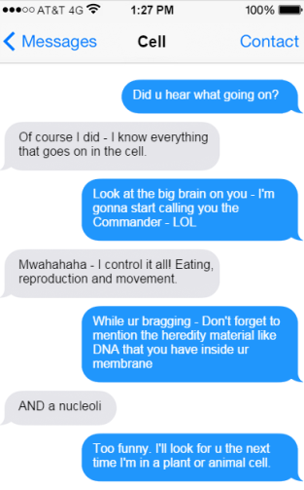
Who am I?
5.__________________
Who am I?
6.__________________

Slide 5
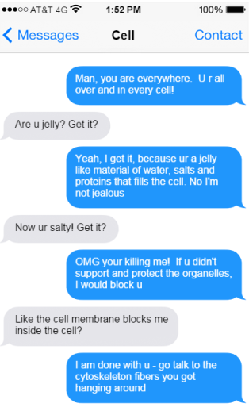
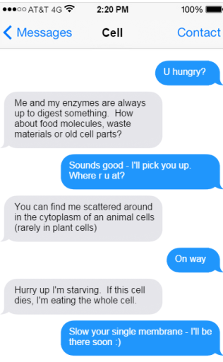
Who am I?
7.__________________
Who am I?
8.__________________

Slide 10
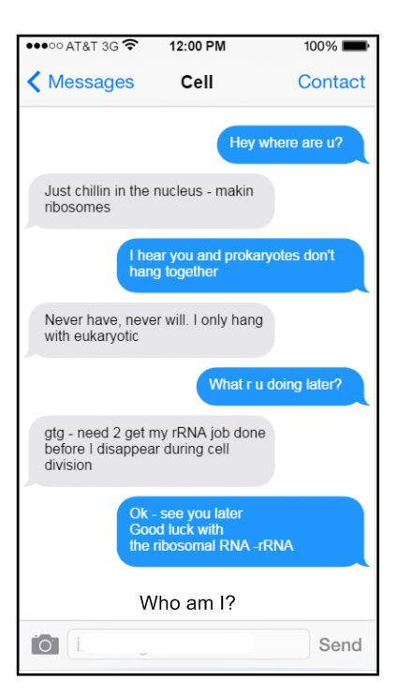

Slide 11
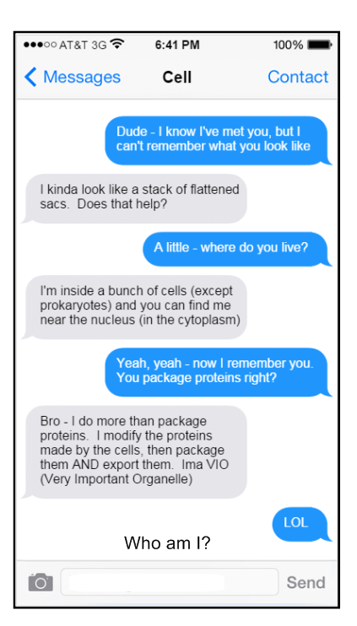

Slide 12
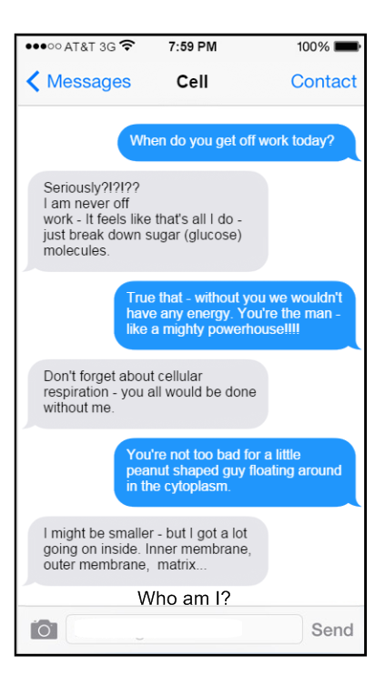

Slide 13
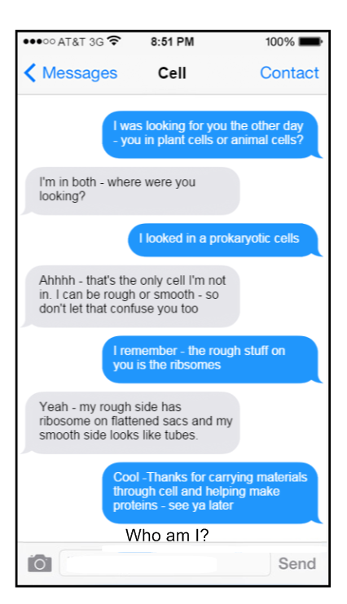

Slide 14
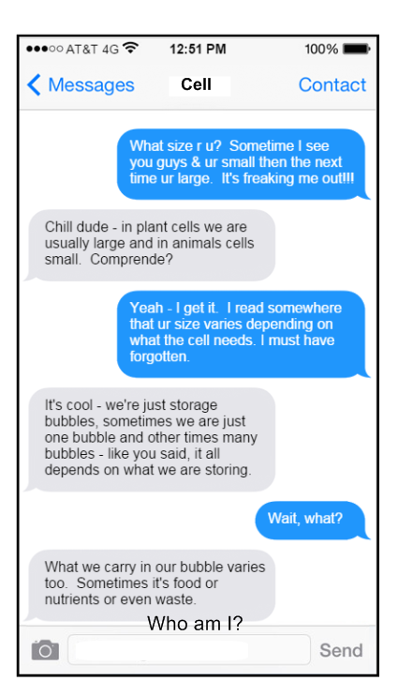

Slide 15
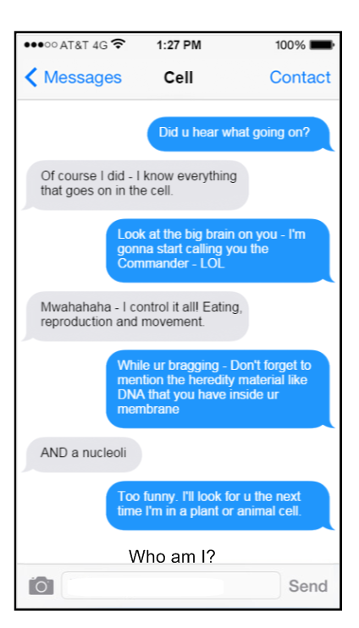

Slide 16
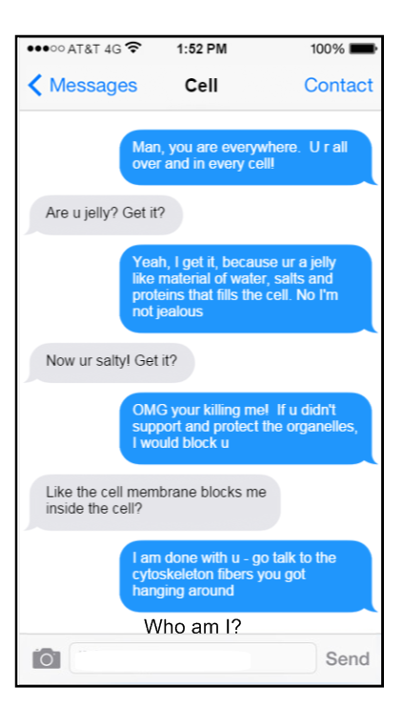

Slide 17
